Slide 1
America at the Turn of the Century

Slide 2
Remember last year? What is happening in America after the Civil War?
1.
2.
3.
4.
5.

Slide 3
America at the Turn of the Century

Slide 4
America at the Turn of the Century
Using our chart, over the next two classes, we will examine the social classes in the United States around the year 1900.
We will examine each of the four classes by looking at the overview, their values, and the problems they faced. Let’s begin with the wealthiest Americans, a.k.a. the leisure class.

Slide 5
Wealthiest
Overview: In 1900, US Population is 76 Million.
The 20 wealthiest families in US-Vanderbilt, Harriman, Whitney, Rockefeller, Carnegie, Morgan—own most of the nation’s wealth. They OWN the oil, the steel, the railroads, the ports, the ships, the coal, the factories, the real estate, the best properties in the USA.
Carnegie & Rockefeller each = over 300 Billion! (3X Bill Gates!)
Who has more power—these families or the gov’t?
George Vanderbilt’s mansion employed more ppl than the US Dept of Agriculture (read p. 12)

Slide 6
C. Vanderbilt’s summer home in Newport, R.I. (“the Breakers”)

Slide 7
Pretty sweet life, huh?

Slide 8
Housing for the working class.

Slide 9
What did the wealthiest Americans value?
They valued the individual over everything! Men like Morgan and Carnegie are what make America great! People who don’t succeed are just lazy or not clever enough! (discuss: Social-Darwinism) Excessive Individualism.
Money can buy anything! They finance most politicians, so politicians favor the wealthy class.

Slide 10
Do the wealthiest have problems?
High divorce rate. Why?
Dissatisfaction with life. Why?
Hard to be a child of a super-rich man. Why?

Slide 11
Let’s examine the Working Class
Overview: over half of all Americans, 40 million. Immigrants, factory workers, working women and children. Income range: $250-650 PER YEAR!
Work with their hands: on docks, coalmines, construction, in other ppls homes, carpenters, tailors, machine operators, in factories.
Mostly live in crowded cities. Do NOT own homes. Rent cheap, unsanitary “tenement” houses in large cities.

Slide 12
Problems of the working class
Hard jobs/Long hours/low pay
Lower life-expectancy
No job security. Premature death or maiming on job.
Working class children do not attend school.

Slide 13
Working Class Problems, Cont’d
Men turn to drinking, prostitution
. . . leads to domestic violence
Poor diet, poor sanitation, overcrowding = disease.
No leisure time at all, ever. Work, eat, sleep, repeat, then die.

Slide 15
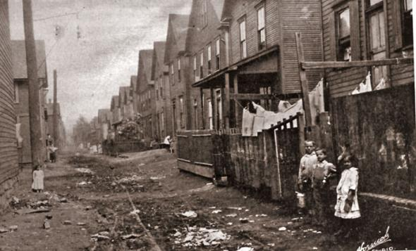

Slide 16
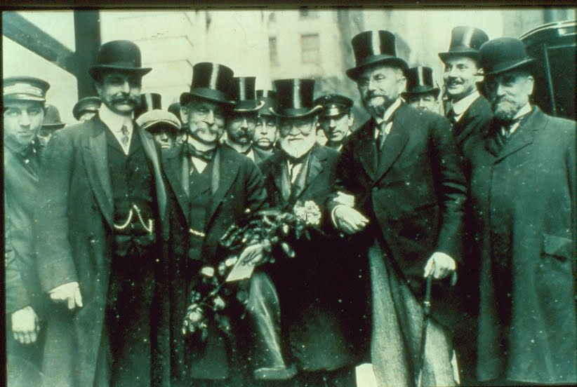

Slide 17
Summing Up
What is population of USA in 1900?
What percentage is working class?
For these Americans, life is a daily struggle for survival.
The nation is controlled by? What would 1% be?
Do the two classes have much in common? Leisure, women, children, the “individual.”
Can America be great in the 20th Century if there are two Americas?

Slide 18
Turn of the Century, Day 2
Farm Families overview. About 30 Million Ppl.
Avg. income = $650 PER YEAR
Worked 7 days/week. Children worked on the farm; they did NOT attend school.
Isolated & Self-Reliant

Slide 20
Goshen, NY farmhouse, 1900

Slide 21
Rural Values
Strong belief in INDIVIDUAL.
Religious.
Distrustful of Big City life

Slide 22
Problems of Farm Families
Crop failures. What happens then?
Isolation from “mainstream” America—not even radios
Poverty/lack of access to hospitals
Children did not want to be farmers; moved from farms. Where did they move?
Many families did not own their land. They rented it as tenants or sharecroppers.

Slide 23
Middle-Class

Slide 24
Recognize this style of house?

Slide 26
Middle-Class
Overview: These are America’s small businessmen, teachers, firemen, doctors, lawyers, clerks, nurses, managers, professionals.
Received a fixed salary (instead of wages per hour) for jobs like Lived in Victorian houses, with nice furnishings.
Earned $1000-2000 year.

Slide 27
Middle-Class values
Believed in self-improvement
Faith in ASSOCIATIONS instead of INDIVIDUALS
Valued hard work & education
Favored moderation & restraint
Had fewer children than other classes
Children raised by stay-at-home mothers. What did other mothers do?

Slide 28
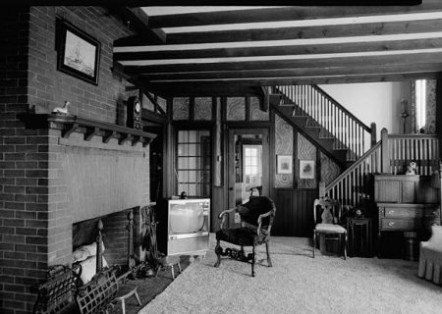

Slide 29
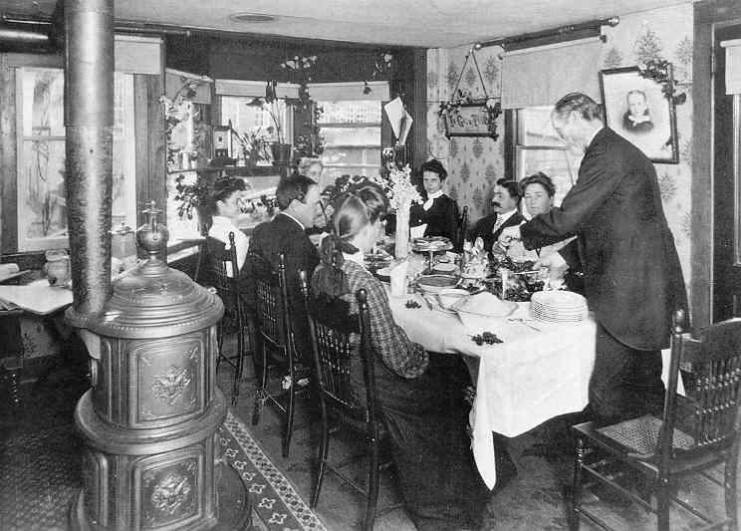
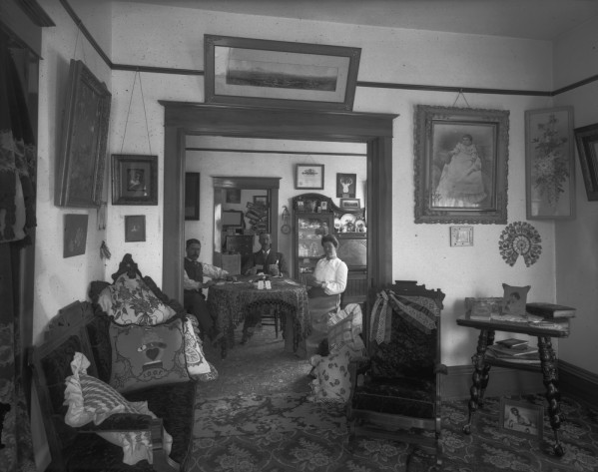

Slide 30
Problems
Caught in the middle between 1% & working class.
Not sure how to cope with higher standard of living. Why?
Problems btw genders. Women did not want their men drinking, gambling, etc.

Slide 31
Summing Up
IF America in the 20th Century is to be a great industrial power, which class will lead America? Whose values will be adopted?
The farmers?
The wealthiest Americans?
The working class?
Who?

