Slide 1
The Tribal ‘20s: Ethnicity & Race
Americans knew that WWI was a turning point, but contested its meaning. What kind of nation would we become? Decades of culture wars have followed.
We will examined religious, racial and ethnic divisions, and cultural divisions.

Slide 2
Tribal ‘20s-Ethnicity & Race
We will examine the tribalism of America in the 1920s as it relates to religion. Today, we will investigate the divisions that existed in the twenties related to ethnicity & race.

Slide 3
Tribal ‘20s-Ethnicity & Race
What are demographics of U.S.A. in 1920?
Population = 105 M
14M foreign born; 22M had foreign-born parent
>1/3d of Americans speak another language at home!

Slide 4
Tribal ‘20s-Ethnicity & Race
Nativists are anti-immigrant. Ex. Nativists v. Italians
(Judge Webster Thayer’s remark)
Deadly anti-Italian riot in West Frankfort, IL Aug. 1920
Unfair Trial & Execution of Sacco & Vanzetti
Excluded from middle-class jobs like attorney…

Slide 5
Ethnicity & Race
Nativists v. Russian/Eastern European/Jewish
Red Scare. Russian Revolution (Communist) in 1917; US fears Russian-Americans will try to turn US communist.
Palmer Raids—series of violent police raids on suspected communists/anarchists.

Slide 6
Ethnicity & Race
CA law forbids Japanese from owning land.
Asiatic Exclusion League had 100K members.
Immigration Act of 1924 sets quotas on immigration. Britain, Germany, Scandinavia are OK; Italian quota 4,000; Japanese quota 200!
Nativists v. Asians

Slide 7
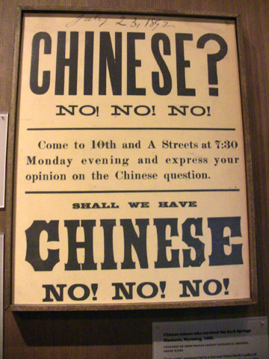

Slide 8
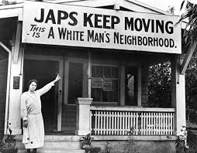

Slide 9
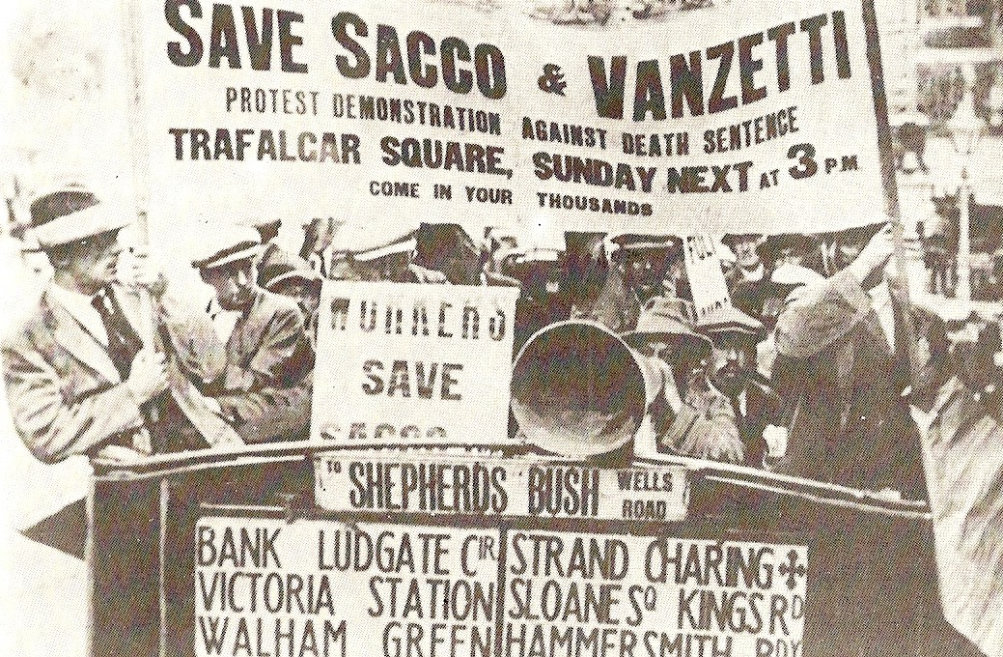

Slide 10
Ethnicity & Race
What were issues of race in 1920s?
Jim Crow laws in South = harsh, segregated way of life
Deadly race riots in 1919. Tulsa, 35 blocks burned, 6K A-A arrested.
By 1924 KKK had 4M members in 4K chapters

Slide 11
Ethnicity & Race
How did A-A respond to harsh, segregated south?
Great Migration. Btw 1916-1970, 6M A-A sought a better life in the cities of the northeast like Detroit, Chicago, NY.
Largest internal migration in American history!

Slide 12
Summary
‘20s are a turbulent decade of cultural divisions along lines of religion, ethnicity, & race.
Great Migration will forever change America.

