Slide 1
Cold War I-1950s Unit
There will be a QUIZ #1 on the national security policy of “containment.” The quiz will be include multiple choice as well as identifying the quote (Who am I?) 25 Mult. Choice.
QUIZ #2 of this Unit will cover the bolded terms from pages 806 to 835: 25 Multiple Choice.

Slide 2
North & South Korea

Slide 3
Korea-Containment Tested
1949 USSR perfects A-Bomb
Oct. ‘49: Communists take control of China
Cause #1: 1949-50 is BAD NEWS FOR USA
(*Spies gave A-Bomb recipe to Soviets)

Slide 4
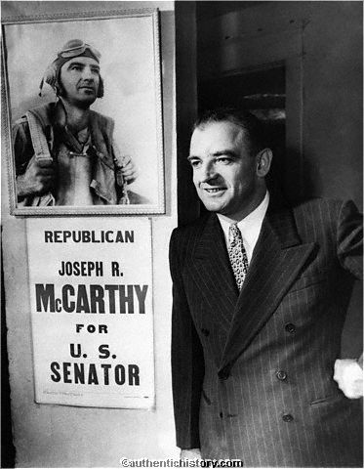
No Notes Here-Let’s Discuss
Effect of bad news on USA
Senators Nixon & McCarthy (R) hammer Truman as “soft on communism.” US “lost China.”
Communists are everywhere! Even INSIDE US!
US must act!

Slide 5
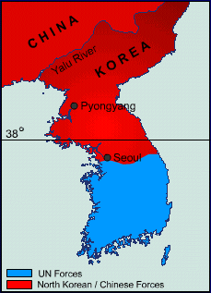
Cause 2
Post-WWII Korea divided at 38th parallel (USSR = North; US = South).
1950: N. invades S.

Slide 6
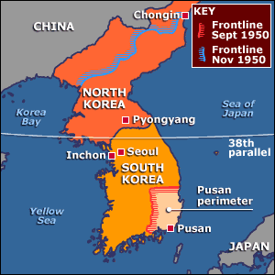
US forces pushed all the way to Pusan perimeter.
US Army under Gen’l MacArthur under UN Flag.
Course 1:

Slide 7
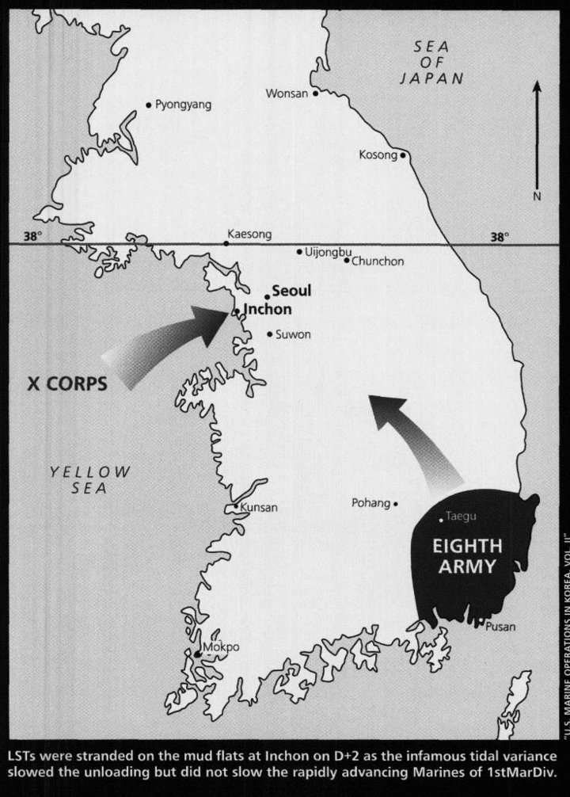
Course 2:
US counterattacks at Inchon—150 mi. behind enemy lines--takes Seoul!
(Q: do we go beyond 38th parallel & rid North of Reds?)

Slide 8
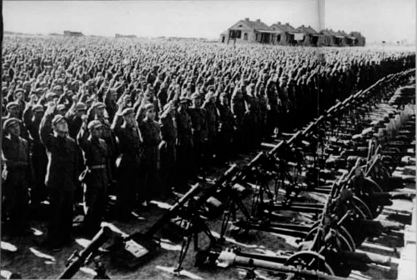
US push deep into N. Korea met by massive Chinese intervention!
(300K Chinese troops chase USA back south in winter of ‘50-’51)
Course 3

Slide 9
Korea Conflict Dance
PU-san!
INCH-on!
YA-Lu!
Chinese Troops!

Slide 10
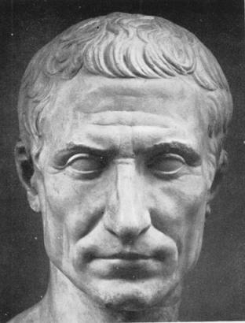
No Notes; Let’s Discuss
March 1951, Mac fights back to 38th parallel, wants to go after China.
“Wrong war at the wrong place at the wrong time with the wrong enemy”—Omar Bradley
Use A-Bomb on Chinese cities?
Put atomic waste in Yalu River?
Truman is fine with status quo at 38th Parallel.
Mac publicly disagrees w/ Truman and is relieved of command.

Slide 11
http://www.nbcnews.com/video/nbc-learn/52589127#52589127

Slide 12
Consequences of Korea
Eisenhower (“Ike”) elected in ‘52 (Nixon is VP). Repubs to be “tougher” on Reds
Am Ppl uneasy w/ no clear victory.
NATO preserved & UN Tested
NSC-68. Massive US defense spending—cont’d to 1980s!
“In war there is no substitute for victory.”

Slide 13
28,000 US troops remain in Korean DMZ

Slide 14
