Slide 1
Segregation, Brown, and Little Rock

Slide 3
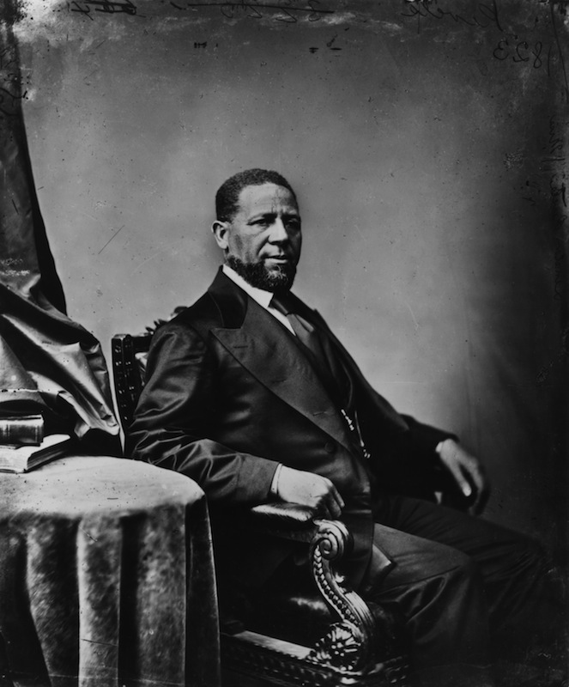
Segregation, Brown, and Little Rock
19th C.
13th, 14th, and 15th Amendments give African Americans freedom & rights of full citizenship.
Sen. Hiram Revels (MS)

Slide 4
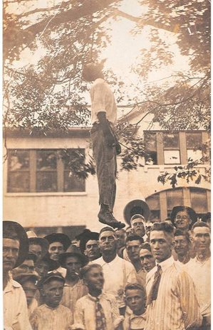
19th. C & 20th C.
After federal troops leave South, states disenfranchise black citizens.
African Americans are prevented from voting; this is enforced through violence.

Slide 6
Sides with segregation in Plessy v. Ferguson (Gandhi scene)
“Separate but equal” becomes law of United States until…
What about the Sup Ct?!

Slide 7
Brown v. Bd. Of Education of Topeka, KS (1954)
Supreme Court rules that separating the races psychological damages African Americans, instilling in them a permanently damaging sense of inferiority.

Slide 9
That brings us to Little Rock . . .
What happened post-Brown case?
Southern states refused to comply with new federal law.
In Sept. 1957, nine African American teenagers sought entry to Central High School in Little Rock, AR

Slide 10
Then what happened?
“Mob rule cannot be allowed to override the decisions of the courts.”
~ Eisenhower
AR Gov. refused to comply with Supreme Court.
Eisenhower sent 1,000 troops from the 101st Airborne Division (!) and federalized 10,000 Arkansas national gaurdsman. The soldiers escorted the Little Rock 9 to their classes.

Slide 11
“Sometimes I can look at it, and sometimes I just can’t.”
Hazel Bryan
Elizabeth Eckford

