Slide 1
Welcome! Please Begin working on your Do-Now.
Today’s Lesson: Circle Exercise

Slide 2
Please Do Now
Analyze the two cartoons:
From cartoon 1 and from our last class—what is sociology?
Look at cartoon 2: Do different societies have different ways of interacting? Give at least one example.

Slide 3
Circle Exercise
1s on inner
1s face OUT
2s on outer
2s face IN

Slide 4
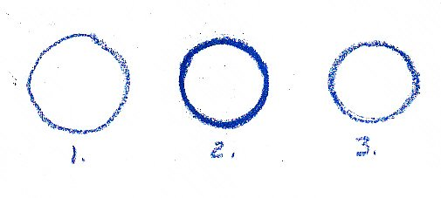
One
Each pair, when I give the signal, is to talk about ANYTHING you want for 90 seconds.
I will let you know when time is up. Inner rotate one
person to right.

Slide 5
Two
Each new pair, when I give the signal you will talk about anything you like EXCEPT school for 90 seconds.
When time is up, Inner Circle rotate one person to right.

Slide 6
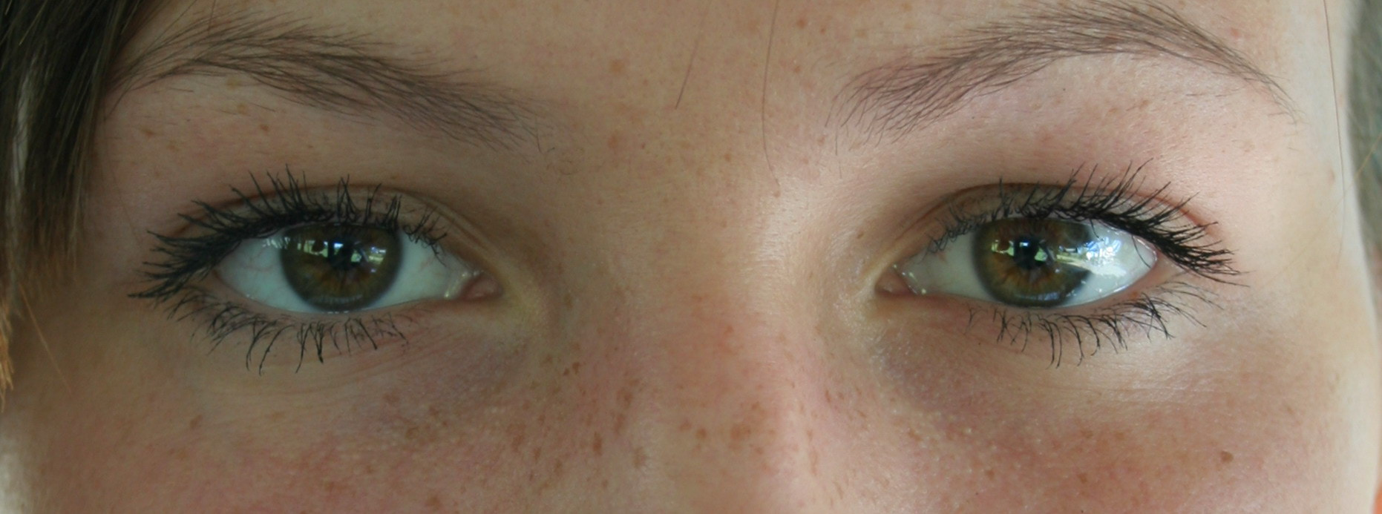
Three
Each new pair to maintain absolute eye contact while talking about anything for 90 seconds.

Slide 7
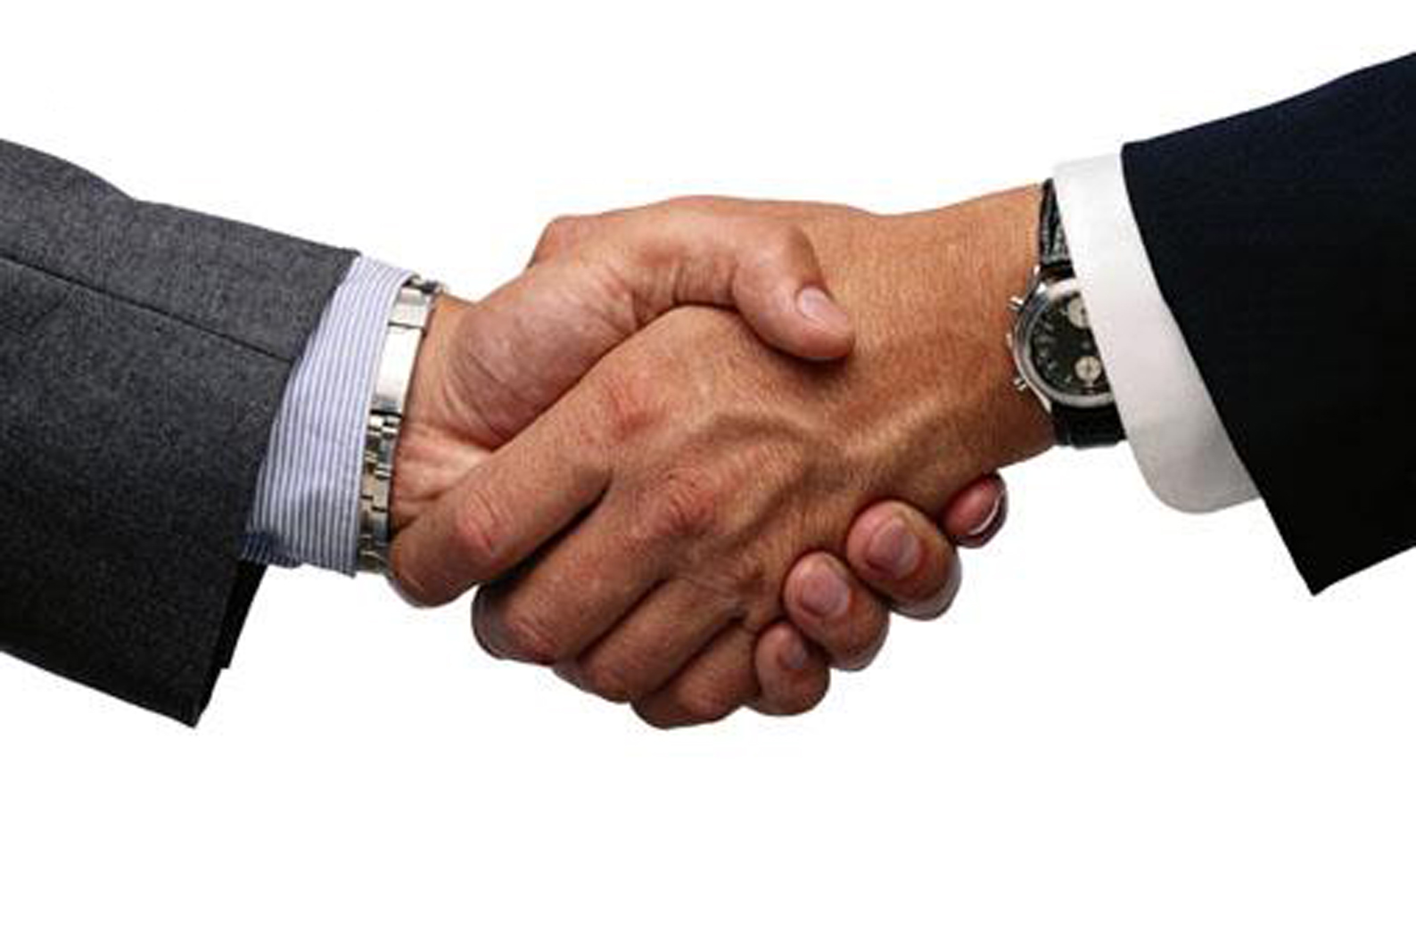
Four
Rotate. Talk about anything while shaking hands or holding hands. 90 seconds.

Slide 8
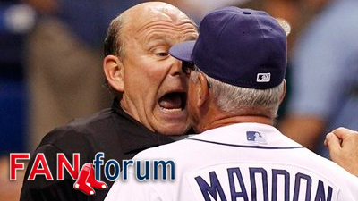
Five
Talk about anything while standing toe to toe for 90 seconds.

Slide 9
six
Rotate. Talk about anything while keeping your hands still at your sides. 90 seconds.

Slide 10
Seven
Rotate. Outer circle kneels while talking about anything for 90 seconds.

Slide 11
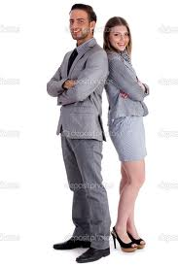
Eight
Talk about anything while standing back to back. 90 seconds. Last one!

Slide 12
Debrief
Great job!
Let’s have a seat. Jot down your top four LEAST COMFORTABLE circle exercises!

