Slide 1
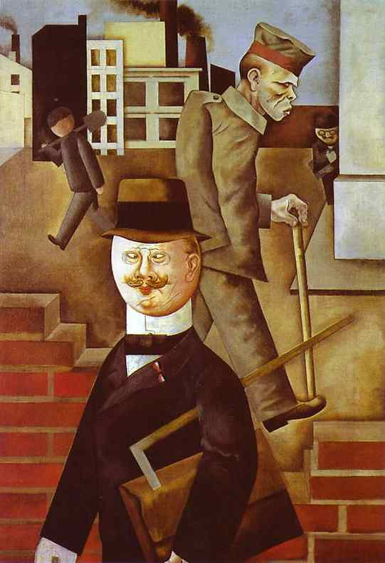
The First World War & the Modern World
“Artists are the antennae of the race.”
Ezra Pound

Slide 2
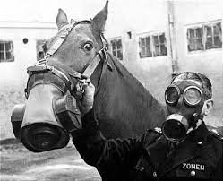
1WW & Modern World
The needless carnage on the Western Front shook previously held Western beliefs.
The world of honor, orderliness, forward progress, was replaced by the world of mass death, illogical decisions, and loss of optimism.
Experts in history and literature, such as Paul Fussell, argue that the First World War CREATED the Modern World.

Slide 3
1WW & Modern World
Today, we will examine how the war changed music, visual arts and literature.
Let’s examine the music of the pre-war & compare that to post-war.
What differences do YOU hear?

Slide 4
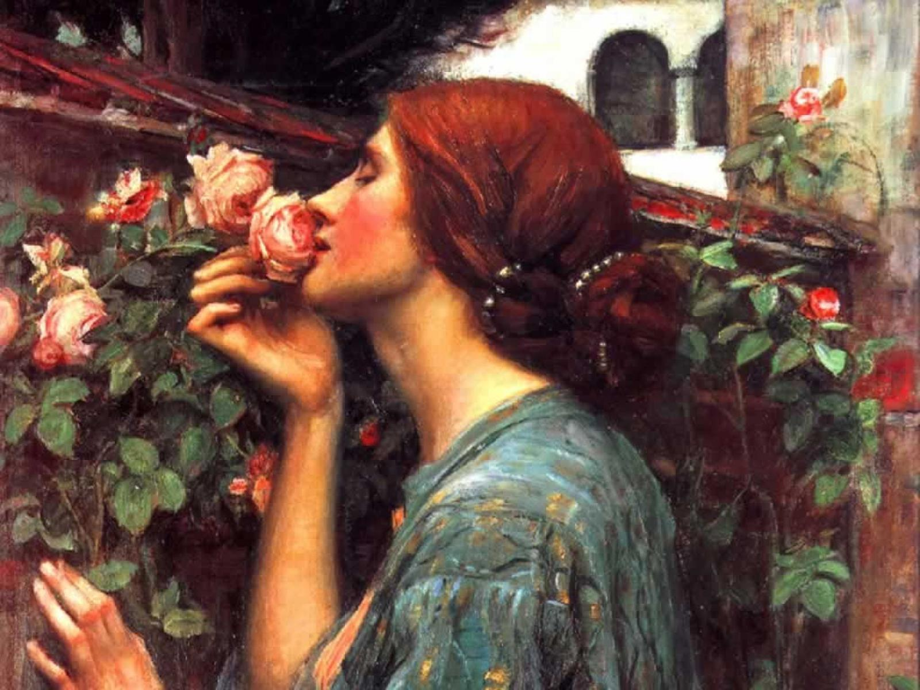
1WW & Modern World
Let’s look at the visual arts before the war.
Pre-Raphaelite School

Slide 5
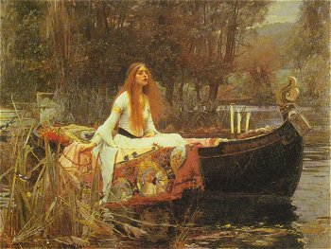

Slide 6
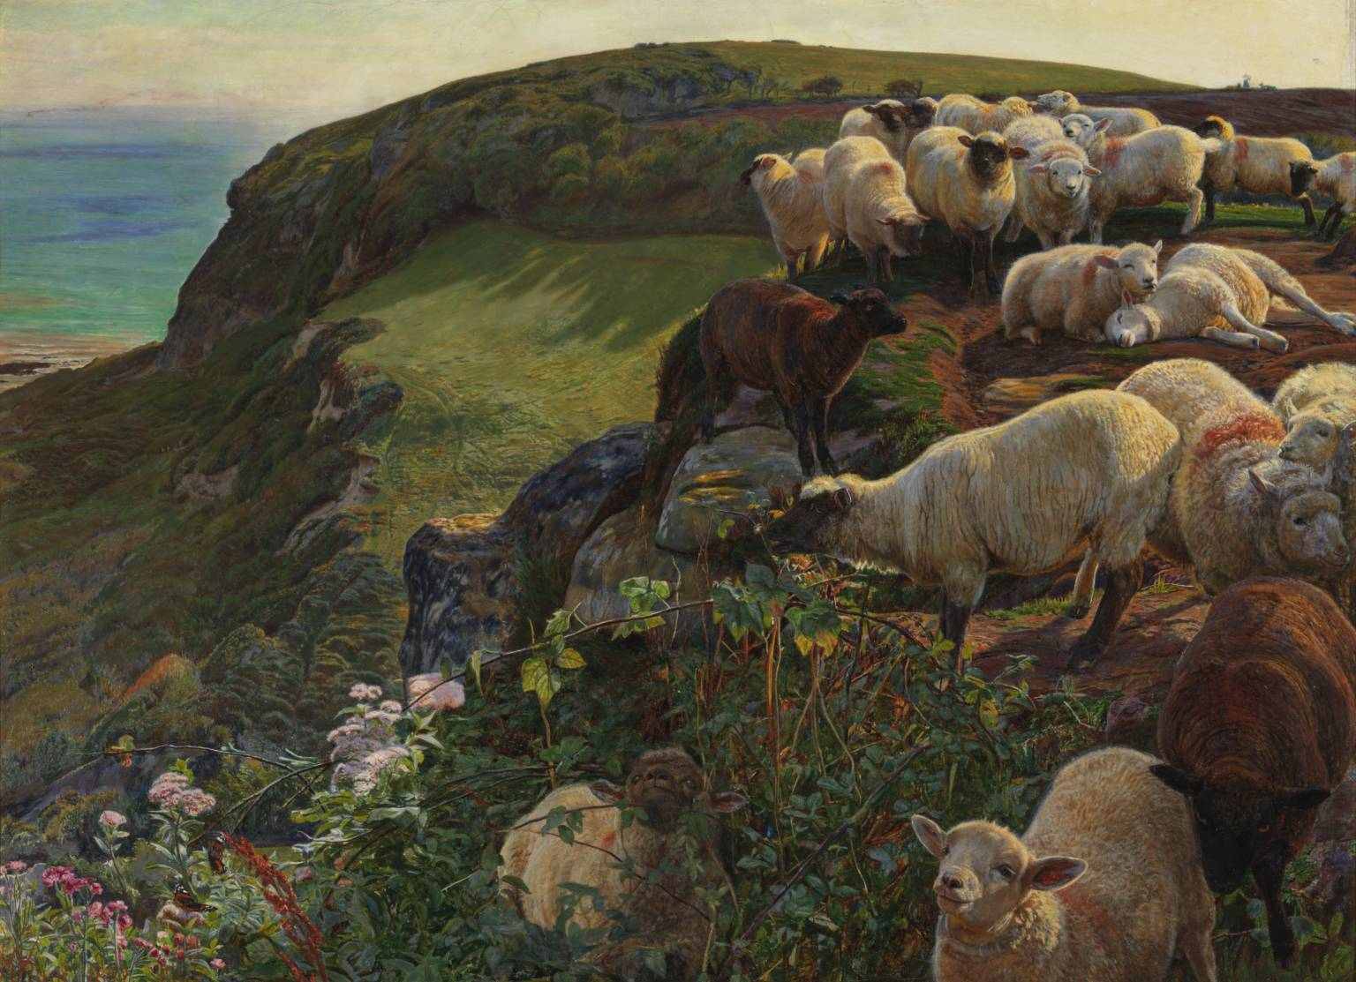

Slide 7
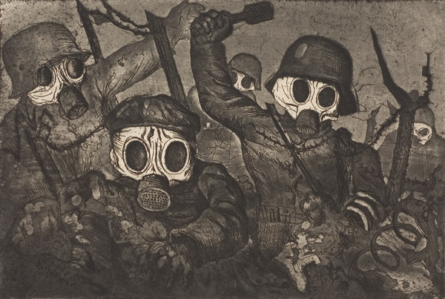
Otto Dix

Slide 8
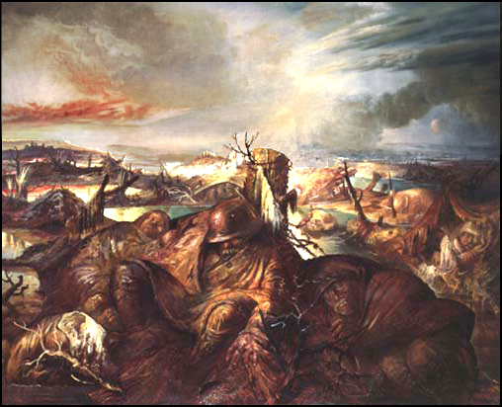

Slide 9
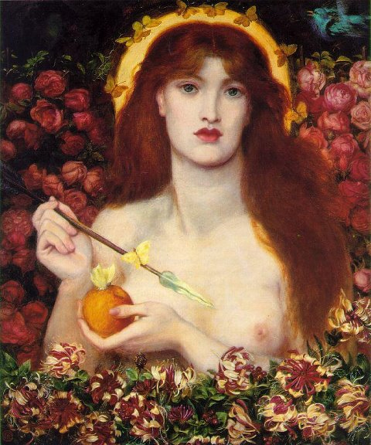
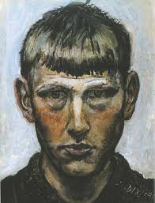
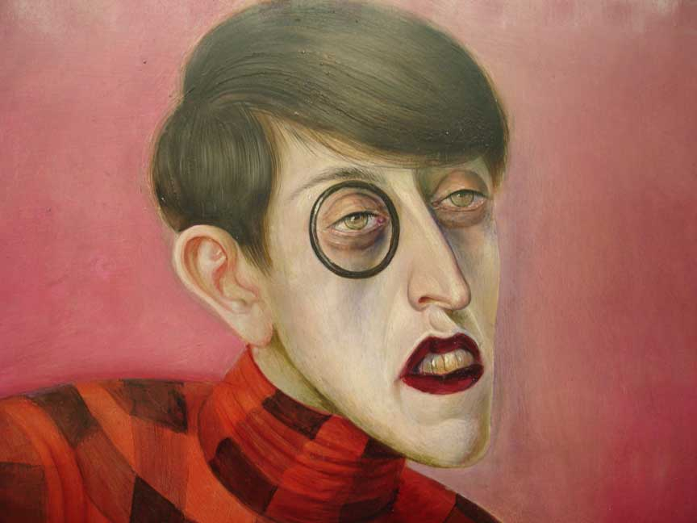
Post-War: Otto Dix

Slide 10
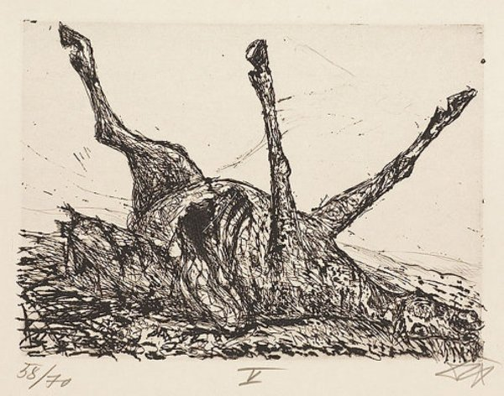
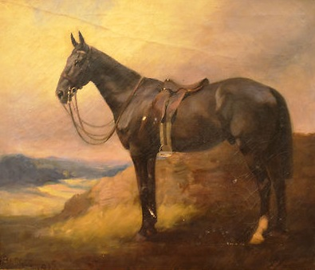
Pre-War/Post-War

Slide 11
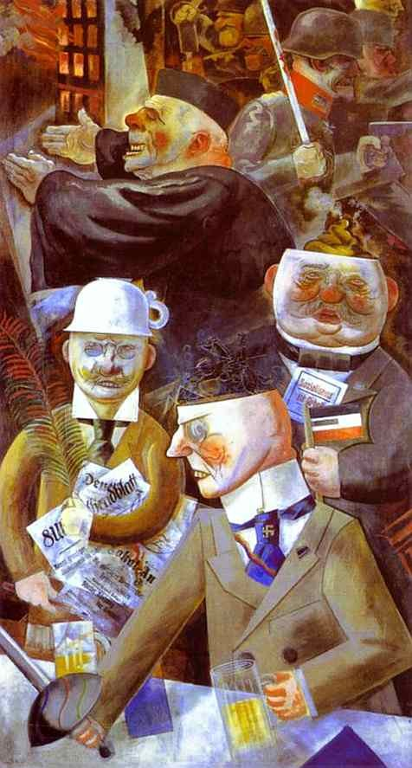
George Grosz:
“Pillars of Society”

Slide 12
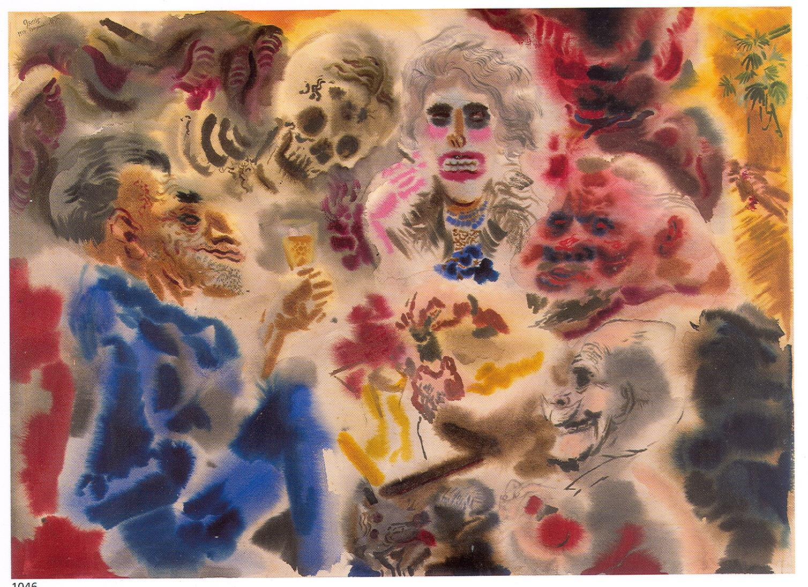

Slide 13
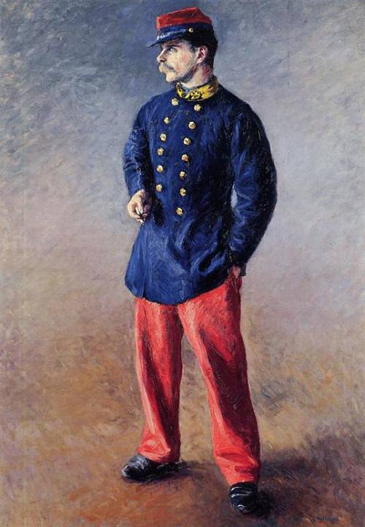
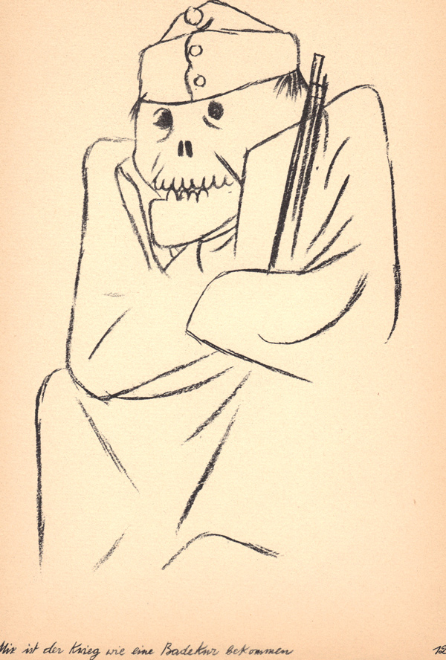
Prewar/Postwar

Slide 14
Let’s examine literature
Pre-war
Kipling
Post-war
Wilfred Owen
James Joyce
Hemingway

