Slide 1
Notes: Impact of Sputnik I—only write what is in RED
On October 4, 1957, the Soviet Union launched Sputnik I into Earth’s orbit.
This was the first artificial satellite in the history of mankind.
And it terrorized the American people. Why?

Slide 2
Sputnik I
Sputnik was a 184 lb. basketball shaped satellite. How did the Soviets get in into Space?

Slide 3
Sputnik I

Slide 4
Sputnik I
What else could the Soviets put on top of the R7 Rocket?
________________________
R7 missile traveled 3,700 miles in August 1957. First ICBM: Intercontinental Ballistic Missile.

Slide 5
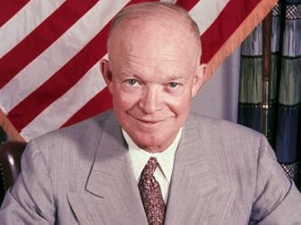
Sputnik I
US Response?
1958 Congress passed the National Aeronautics and Space Act (NASA)
National Defense Education Act, funding for ed at all levels but esp. science & engineering

Slide 6
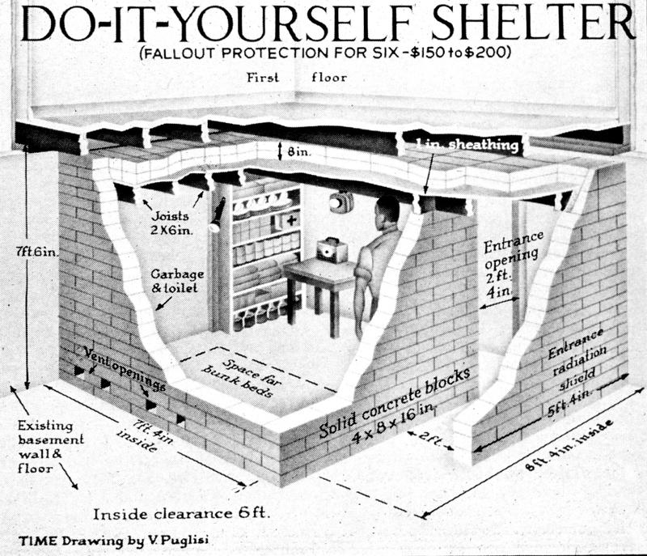
Sputnik I
CONELRAD (Emergency Broadcasting System)
Americans urged to build bomb shelters
OK. Let’s read CONELRAD & WATCH THE SHELTER
Other responses…

