Slide 1
Malaise: The 1970s
The 1970s are a decade in which American faith in government, ourselves, and our place in the world crumbled. The ERA OF DEMOCRATIC-PROGRESSIVISM, THAT LASTED FROM FDR TO JOHNSON, COMES TO A CRASHING HALT.
For the entire decade the American people felt a keen sense of malaise (feeling of unease, of not being healthy, unhappiness)
Apr. 1968, MLK assassinated in Memphis by white supremacist.
June 1968: Robert Kennedy assassinated while campaigning to be Dem nominee in 1968 Presidential election.
Then comes 1969…

Slide 2
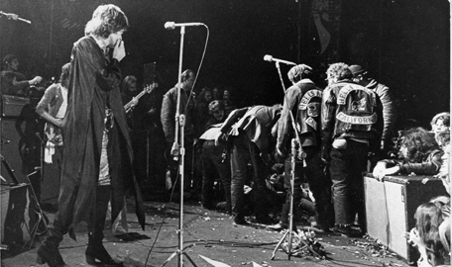
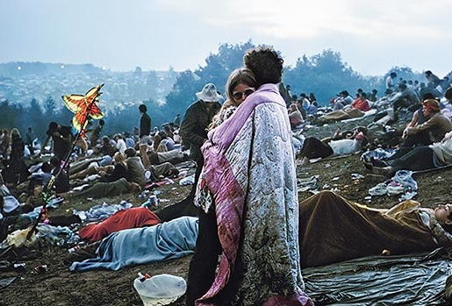
1969
Altamont (murder)
Woodstock (peace, love)

Slide 3
Hippie Communes → Manson Cult

Slide 4
Campus Peace Mvt → Weather Underground (domestic terrorism)

Slide 5
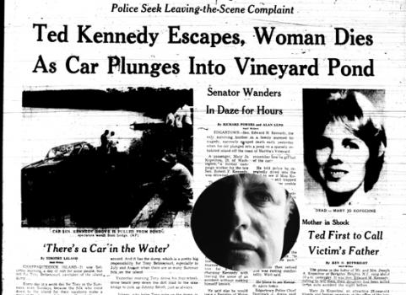
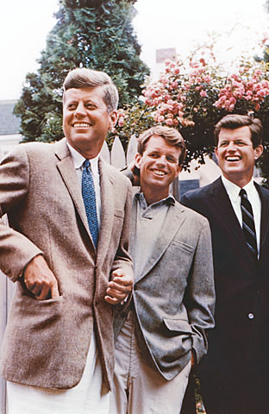
Kennedy Magic → Chappaquiddick

Slide 6
My Lai Massacre

Slide 7
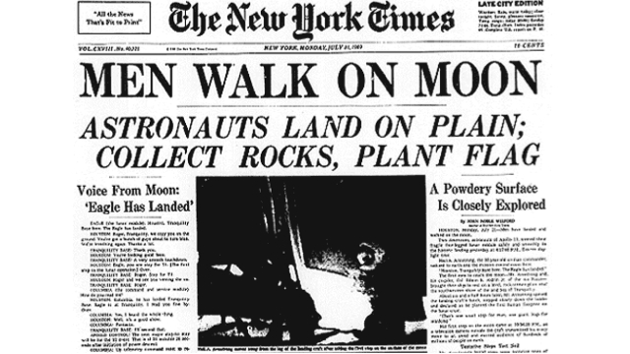
2 good events in 1969

Slide 8
Nixon’s first term (1968-1972)
Created Envt’l Protection Agency (EPA)
Office of Mgt & Budget
Office of Energy Policy
Broadened CR Comm’n to include sex discrimination
Signed all CR legislation, incl. Title IX which banned sex discrimination in education
Expanded enforcement of Affirmative Action (define)
1st time since WWII that gov’t spending on human resources > defense budget!

Slide 9
Nixon’s 2d Term (1972-Aug. 1974)
5 men caught breaking into Watergate Hotel in DC in June, 1972. Men part of Comm. To Re-Elect the Pres. Objective was to steal info from Dem Nat’l Comm HQ.
Nixon ordered CIA to block FBI investigation—then lied that he had done so--the cover-up.
By 1974, Senate investigators and Wash Post learned of the cover up thru tape recordings of Nixon & aides.
Impeachment papers were drawn up. Nixon resigned in Aug 1974.
Watergate scandal utterly paralyzed USA for 2 yrs. Overshadowed Nixon’s presidency.

Slide 10
Gerald Ford (Aug 1974-1976)
Pardoned Nixon in ‘74/Am PPl never forgave him
Est’d Special Ed in 1975
Played center on Michigan Wolverines football team in 1930s.
Worst economy since Great Dep (until 2008…._

Slide 12
Jimmy Carter (1976-1980)
Created Dep’t of Energy; Made Dept of Ed its own agency
Returned Panama Canal to Panama to improve relations w/ Latin Am (Am PPL not happy)
Unable to deal with 1979-80 Iranian Hostage Crisis. 66 Americans held 444 days. Carter’s attempt to rescue them was a fiasco—8 servicemen dead.
Ineffectual, rudderless leadership. A shadow of great Dem-Progressives. Worst Dem pres in 20th C. Sets up Repubs for long run!

Slide 13
1979

Slide 15
Foreign Policy in 1970s
1972-Nixon visits Red China
1972-Munich Massacre
1973-Yom Kippur War
1974-OPEC Oil Embargo
1978-Camp David Accord: Peace btw Israel & Egypt
1979-Iranian Revolution/Hostages
1979-USSR invades Afghanistan
1970s: Détente: Easing of CW tensions btw USSR/USA

Slide 16
ARPANET in 1970

Slide 17
ARPANET in 1982

Slide 18
Internet, 1993

