Slide 1
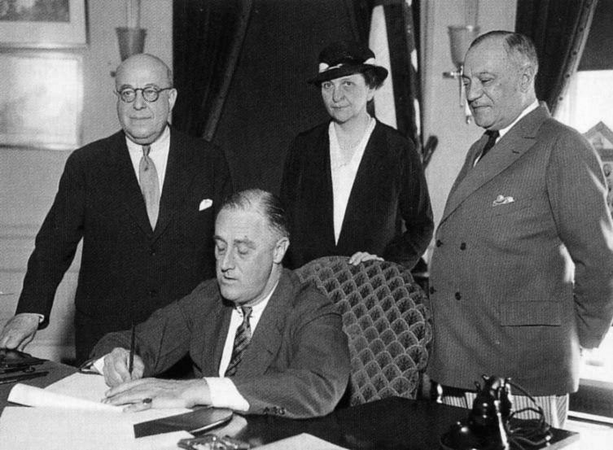
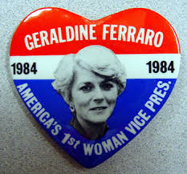
American Women in the Fifties
Activator: List FIVE prestigious American women—from 1900 to present day (movements, politics-government, the arts).

Slide 2
Women in 1950s
“Value of a Housewife” video
“How to be a Good Housewife” Reading

Slide 3
Women in 1950s
Men return from WWII, retake jobs
Women, now unemployed, turn to home; find solace in consumer goods
CW makes strong American family life a defense against Communism

Slide 4
TV Dinner & Spanking

Slide 5
Outfit & Ketchup

Slide 6
Sport shirt & Beer

Slide 7
Tights & Vacuum

Slide 8
Ties

Slide 9
By artist Eli Rezkallah, 2018

Slide 13
Women in the Fifties
Summary: Are the findings of the two women researchers accurate?

