Slide 1
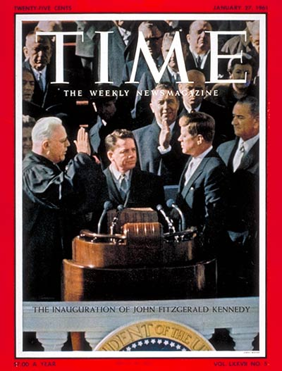
JFK Four Crises
A Cold War Inaugural Address (Jan. 1961)
“Let every nation know, whether it wishes us well or ill, that we shall pay any price, bear any burden, meet any hardship, support any friend, oppose any foe to assure the survival and the success of liberty.”

Slide 2
Crisis 1: The Bay of Pigs
Background--Fidel Castro seized Cuba in 1959, took over U.S. property & allied w/ USSR.
Eisenhower worried that Cuba would inspire communist revolution elsewhere in Latin American, so the CIA developed plans to invade Cuba with anti-Communist exiles to overthrow Castro.

Slide 3
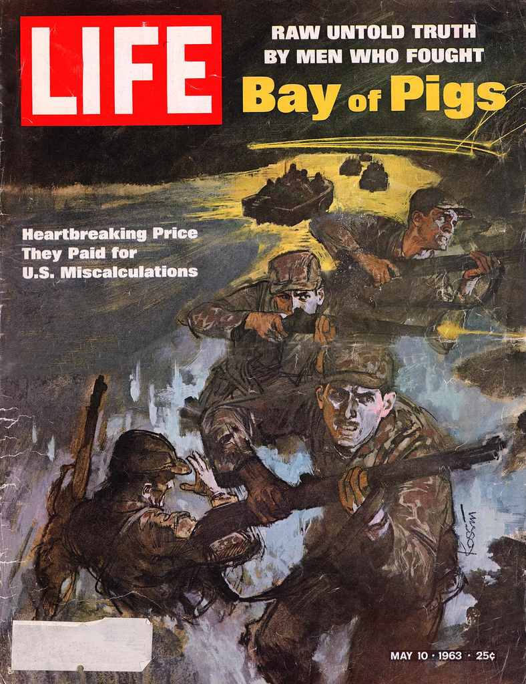
Bay of Pigs Outcome
JFK allowed the attack to go forward in Spring 1961-he asked few questions.
Airstrike failed to destroy Cuba’s air force; Castro stopped U.S. backed troops.

Slide 4
Bay of Pigs Significance
U.S. lost prestige! The invasion was an illegal attempt to overthrow a legitimate government! Latin America angry at the U.S.
JFK became skeptical of the CIA, and publicly took responsibility for the botched invasion: “there is an old saying that victory has a hundred fathers and failure is an orphan….I am the responsible officer of this government.”

Slide 5
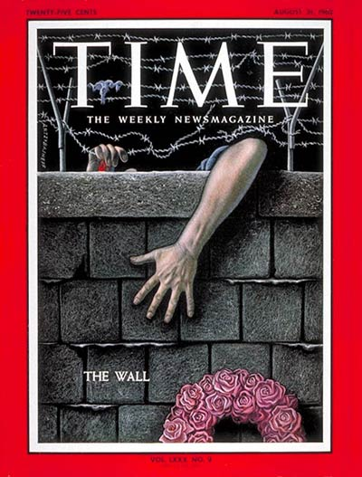
Crisis 2: The Berlin Wall (1961)
Khrushchev intimidated JFK at a mtg in Vienna in June ‘61 and decided to test the new President.
Soviets built Berlin Wall to stop E. Germans from leaving for the West.

Slide 6
Berlin Wall
Outcome:
JFK stands up to Soviets:
  Increases defense spending by $3B.
  Asks for more men for the armed forces.
  Doubled # of young men being drafted.
  Sought $200 million for a program to build bomb shelters.
Significance:
Soviet Russia built a wall around Berlin—the Berlin Wall which became a symbol of the East-West conflict for the next three decades. It fell in 1989.

Slide 7
Crisis 3: The Cuban Missile Crisis (1962)
You & your partner can complete this on your own.

Slide 8
Crisis 4: Vietnam
Background: French defeated in 1954. U.S. backs Diem, a poor leader. North is led by Communist Ho Chi Minh. North is supported by China. Diem assassinated Nov 1963. JFK had secured Europe, wanted to do the same with Asia.
“But I don't agree with those who say we should withdraw. That would be a great mistake.... [The United States] made this effort to defend Europe. Now Europe is quite secure. We also have to participate—we may not like it—in the defense of Asia.” --JFK, Sept. 1963

