Slide 1
Nazi Europe, 1939-41

Slide 2
Nazi Europe, 1939-1941
Sept 1, 1939. German Wehrmacht unleashes blitzkrieg on Poland.
Quick, highly mobile armored units supported by dive bombers.
http://www.youtube.com/watch?feature=player_detailpage&v=Koi8421T7fk
Beginning of Second World War (2WW or WW2)
(Gleiwitz Incident).
(Polish Calvary).

Slide 3
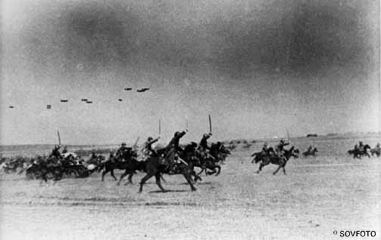

Slide 4
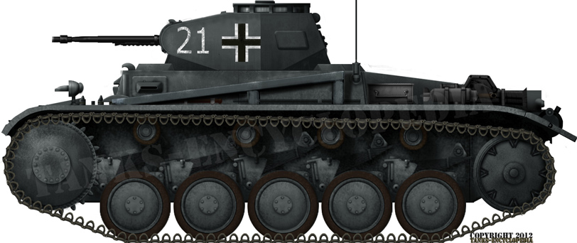

Slide 5
Nazi Europe 1939-1941
Germany attacks France on May 10, 1940. By June, France surrenders.
Sets up pro-German gov’t in s. of France, Vichy France. Still a sore subject.
Britain & France declare war on Germany.
(Staarsgard book; map showing encircled French)
(French Gen’l DeGaulle escapes to London.
Collabos)

Slide 6
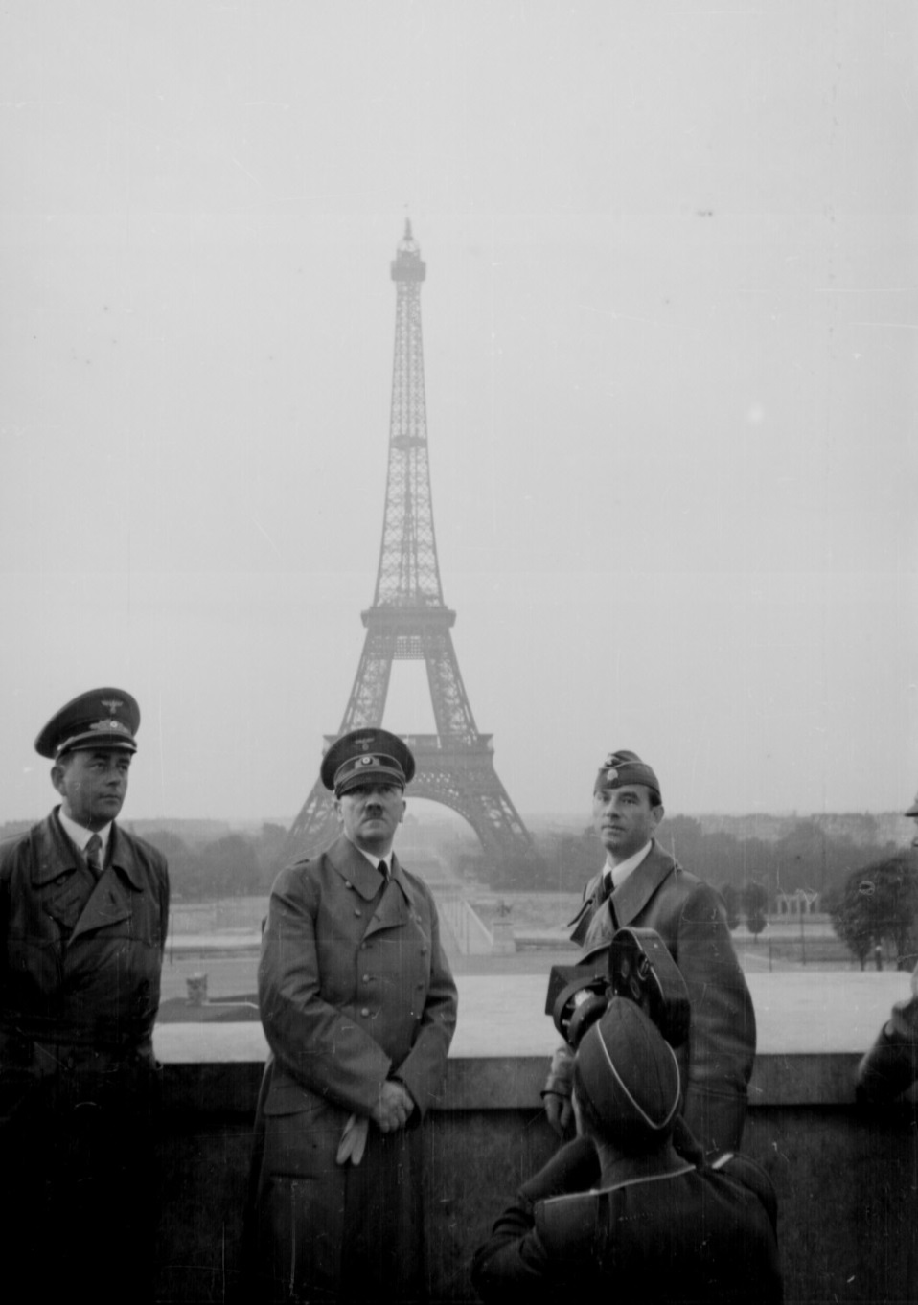
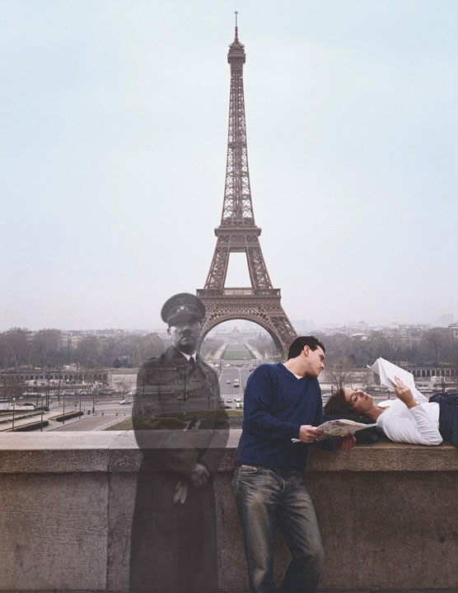

Slide 7
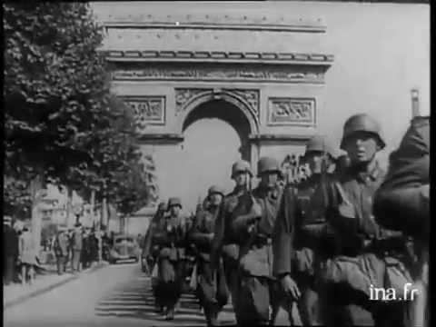

Slide 8
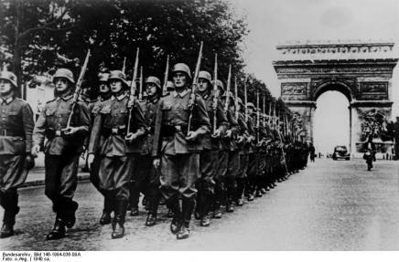

Slide 12
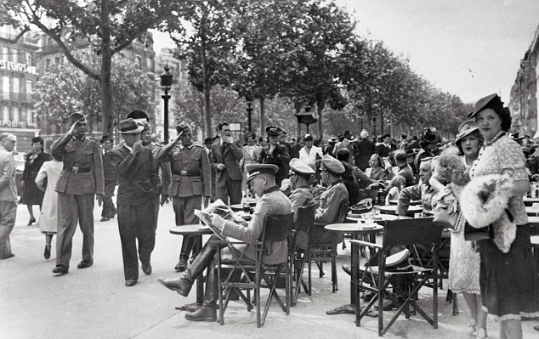

Slide 13
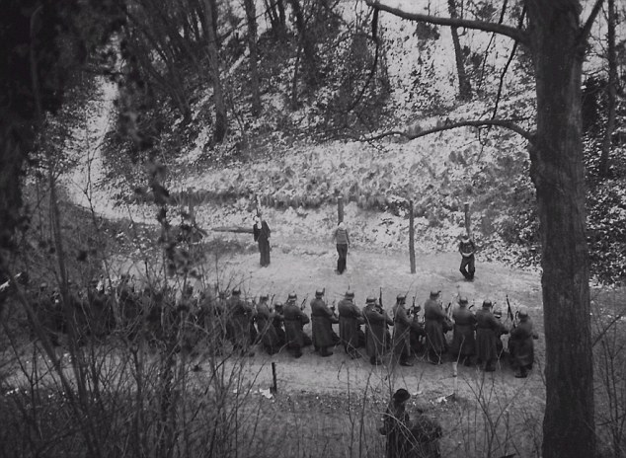

Slide 14
Mock execution of French Resistance fighter, George Blind, 1944. (Later killed in death camp.)

Slide 15
Nazi Europe 1939-1941
German Wehrmacht also conquers:
Luftwaffe v. RAF + RADAR = Battle of Britain (Weapons of WWII)
Denmark, Norway, Belgium, Holland. Attacks USSR June 1941…
Does NOT defeat Britain b/c does not invade, just air war. Brits have radar.

Slide 16
Neville Duke, Francis Mellersh, RAF Pilots (Churchill quote)

Slide 17
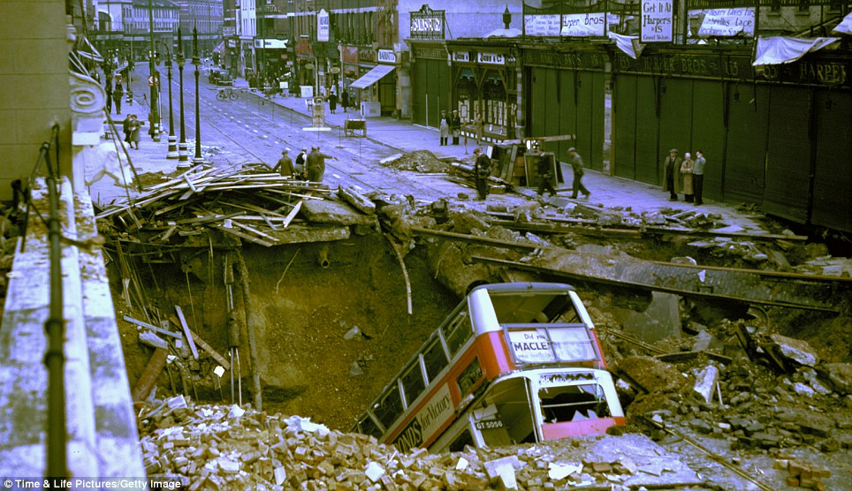

Slide 18
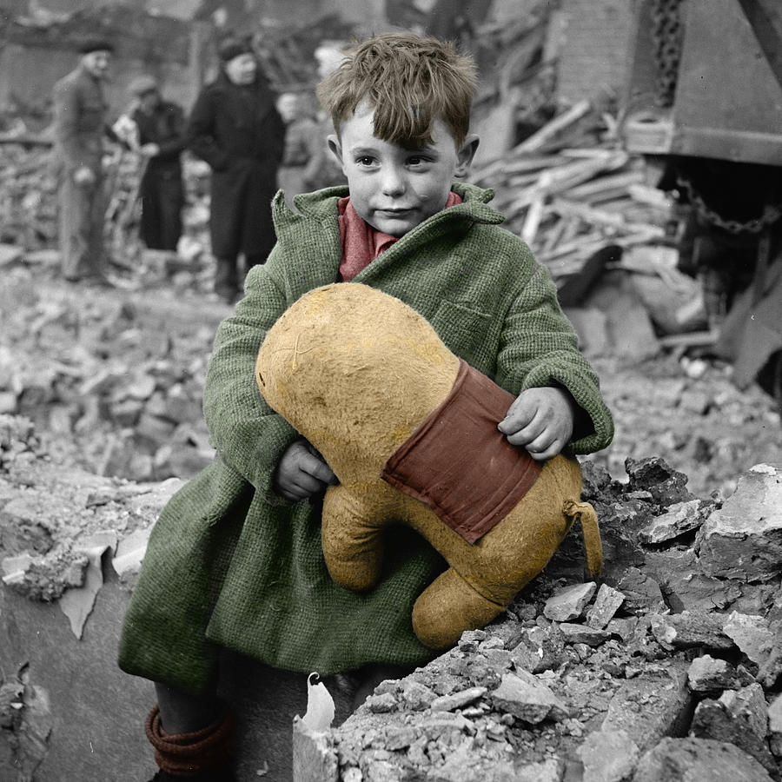

Slide 19
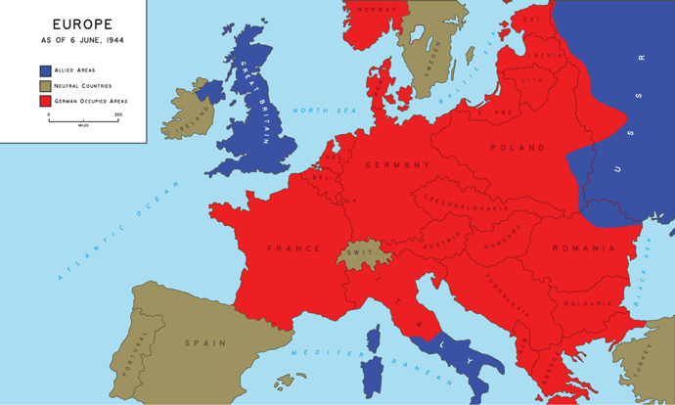

Slide 20
Questions
Can fascism exist without “normal” moral people supporting it?
You are a US Congressman in 1940. What do you do now?

Slide 21
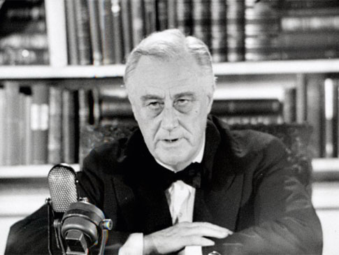
Nazi Europe, 1939-1941
What is US doing 1939-1941?
Loaning Brits destroyers, $, other aid.
FDR wants to keep Britain alive, but Congress will not declare war…
War, hwvr, will come to US—not from Germany…

