Slide 1
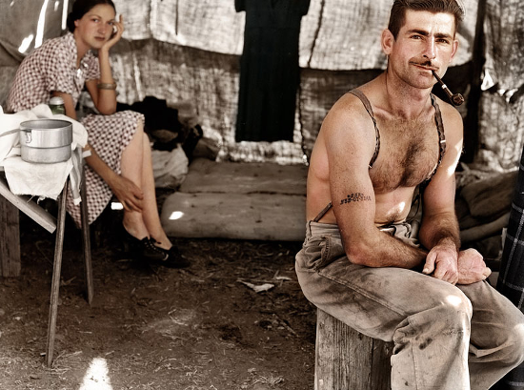
Hoover & Catastrophe

Slide 2
No notes-just think…
What is the purpose of our government?
What can we do (or should we do) if our government fails in this task?

Slide 3
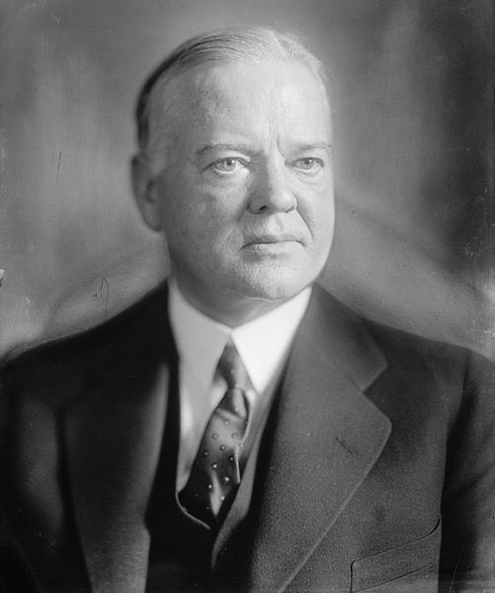
Hoover & Catastrophe
Herbert Hoover
Lean Years, 247---
A hero for feeding Europe during WWI
Won 1928 election v. Dem. (Catholic) Al Smith. 3d straight Repub. POTUS
Laissez-faire BUT wanted protectionist tariffs for US industry.

Slide 4
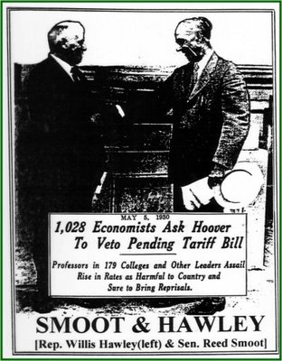
Hoover & Catastrophe
Hoover as POTUS
Hawley-Smoot Tariff, 1930; tax on 20K imported goods, highest in U.S. History.
Results: Imports from Europe decrease from $1.3B to just $390M btw 1929-32; U.S. exports to Europe decreased from $2.3 in 1929 to $784M in 1932.
Overall, world trade decreased by 66% btw 1929-1934!

Slide 5
So…..
By 1928-29, what domestic sectors are failing?
What sectors are doing well?
What is status of international commerce post-Smoot-Hawley?

Slide 6
Hoover & Catastrophe
Timeline, fall of 1929
Sept. 3: US stocks reach highest value ever.
Irving Fisher says stocks have reached “permanently high plateau”
Sept. 20: London Stock Exchange crashes.
Thursday, October 24. 13M shares sold—minor panic (Black Thursday). Bankers (Morgan, Chase) used own $ to buy shares—signaling confidence.
Newspapers over weekend explained all this…
Investors just panicked more. Big sell off on Monday, Oct. 28, 1929, then…

Slide 7
Black Tuesday
October 29, 1929. 16M shares sold in panic.
40% of US wealth destroyed.
By Nov. 13, 1929, $100B had disappeared from the US economy.
Margin loans were called in. Life-savings were wiped out, and ruined men jumped from NYC hotel windows.
Police were called to Wall St. to maintain order.
Individuals lost $, businesses lost $, BANKS lost $!

Slide 8
Hoover & Catastrophe
Take out your Stock Sheet
Step 1: Calculate your wealth
Step 2: Reduce that by 40%
Step 3: Where do you keep your remaining money?
Is there a problem with Step 3?
Tomorrow you will be an economist and examine the cause(s) of the Great Depression.

Slide 9
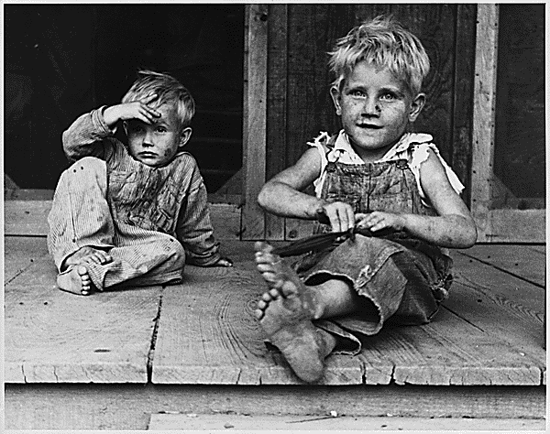
Day 2: Why was this downturn the Great Depression?

Slide 10
Hoover & Catastrophe
Leading econ. Milton Friedman gives the “monetarist” explanation:
GD was so deep & lasted so long b/c of poor monetary policy.
1. Easy Credit in ‘20s.
Encourages buying on credit ($ you have in future)
Which means MORE production
Stock speculation (same as above)
Basically increases $ supply!
What happens when shock comes?

Slide 11
Catastrophe
Monetarist explanation:
2. Farm crisis of ‘20s.
Since 1919, prices fell as yields rose.
Farmers at this time mostly poor & in debt to begin with
Millions in poverty

Slide 12
Catastrophe
Monetarist explanation:
3. Fed Reserve raises interest rates in 1929—shrinks $ supply.
This is bad for debtors b/c creditors want to be paid!

Slide 13
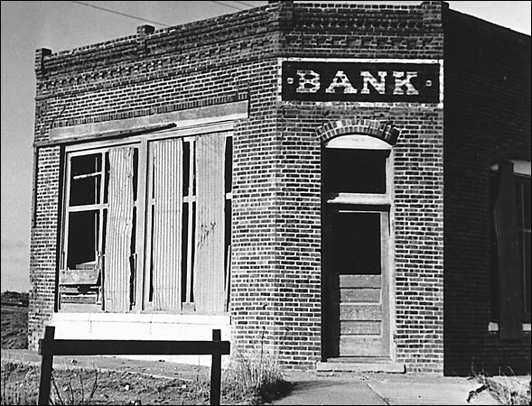
Catastrophe
After crash, no confidence that $ will be safe at your bank.
So, “run on banks.” PPl take savings out of banks at same time.
In 1930, 1,300 banks closed. In ’31-’32 another 3,700.
Even is you didn’t invest in stocks, you lost $ in GD.
4. Banking Crisis

Slide 14
Catastrophe
Think of the U.S. economy as a body.
Money is its blood.
If blood flow decreases body sickens and dies.

Slide 15
Catastrophe!
Summary: the four factors that led the money supply to fall by over 1/3 from October 1929 to March 1933.
1.
2.
3.
4.

Slide 16
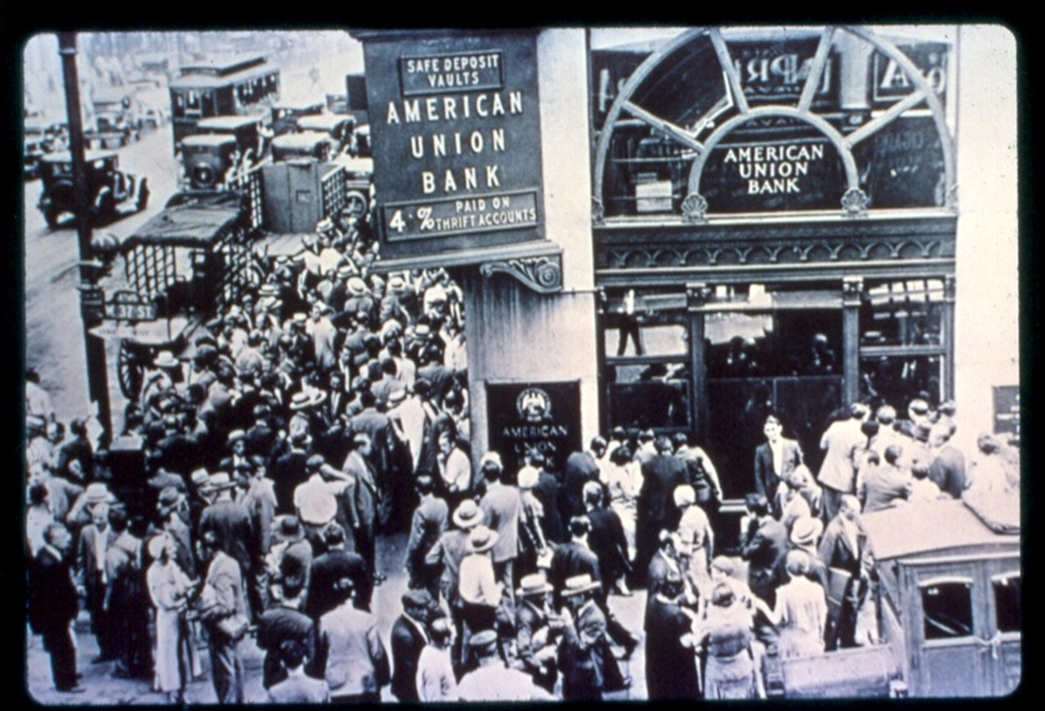
Day 3: The Deflationary Spiral

Slide 17
Catastrophe!
The Deflationary spiral.
#1: contraction of $ supply; smaller cash flow for companies.
This leads to #2
#2 leads to #3
#3 leads to #4

Slide 18
Catastrophe!
Unemployment also leads to #5
#5 leads to #6
And on and on and on does the deflationary spiral!
How do you STOP the downward spiral?
Is there a problem with this approach?

Slide 19
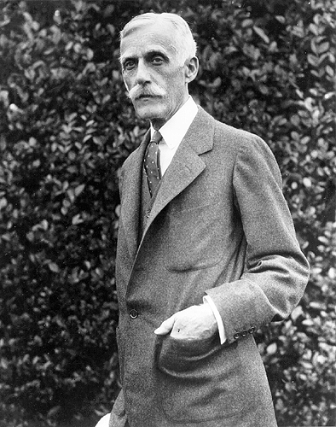
Funny Things Oligarchs Say:
“Liquidate labor, liquidate stocks, liquidate the farmers…People will work harder, live a more moral life.”
--Andrew Mellon, US Treasury Secretary (worth $300-400M)

