Slide 1
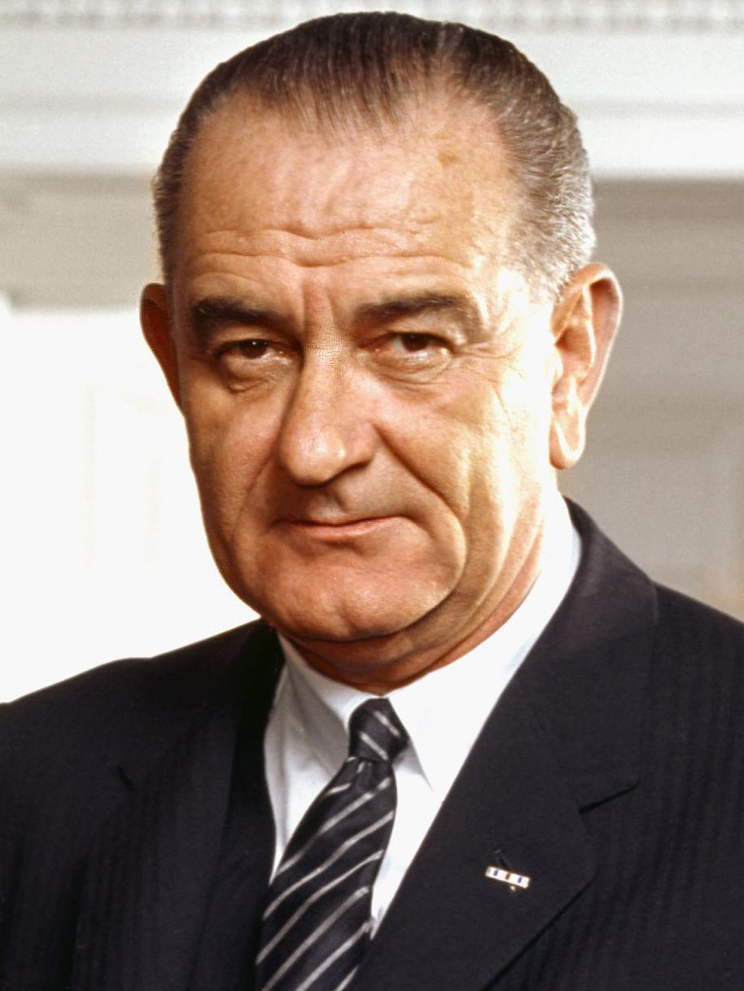
LBJ’s Great Society
No notes yet. We’ll use chart.
Upon the death of JFK, Lyndon Baines Johnson, former teacher, New Dealer, Congressman from Texas, then Senate Majority Leader, is sworn in as the 36th POTUS.

Slide 2
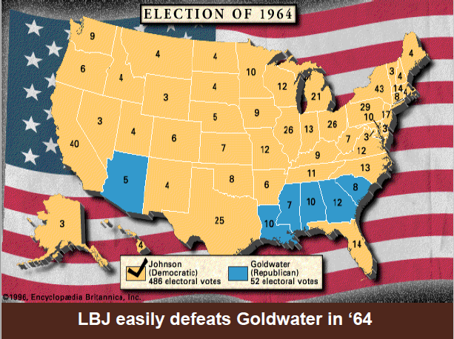
LBJ crushes Goldwater, 1964

Slide 3
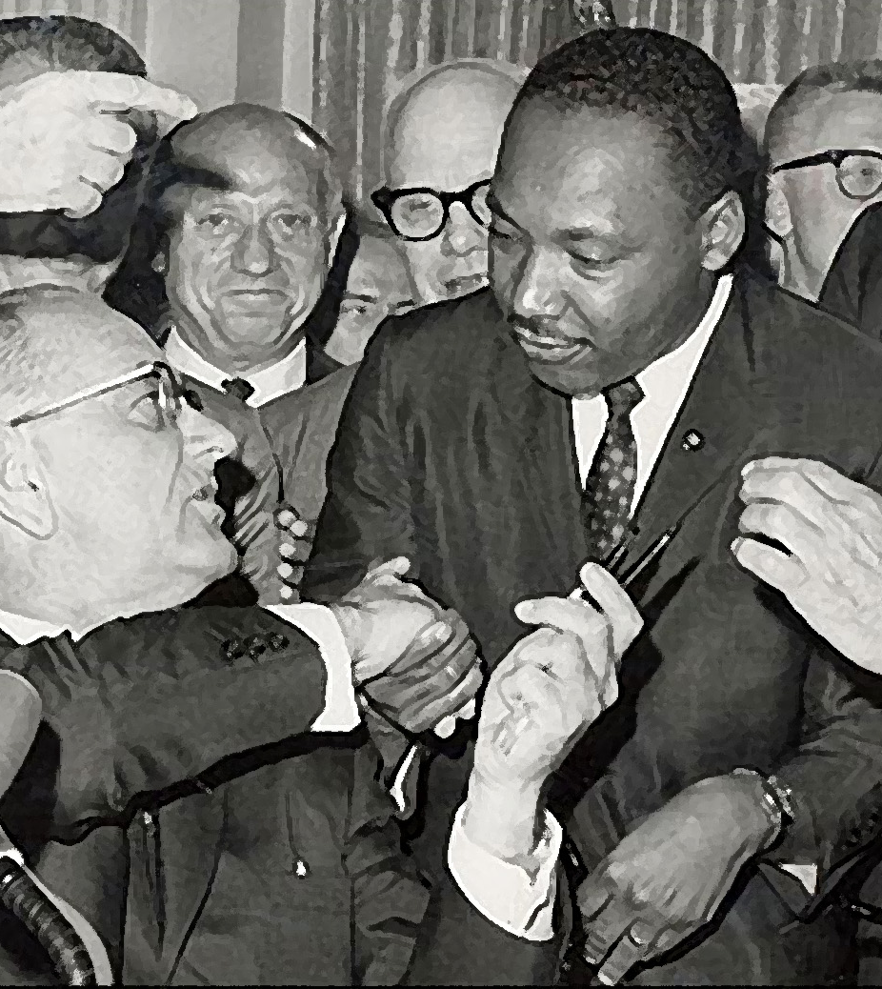
Civil Rights
Civil Rights Act of 1964. Took 100 years!
  prohibited discrimination based on race, color, religion or nat’l origin . . .
  Granted fed’l gov’t new powers to enforce the law! Act prohibited discrimination based on race, color,
religion or national origin, and granted the federal
government new powers to enforce the law

Slide 4
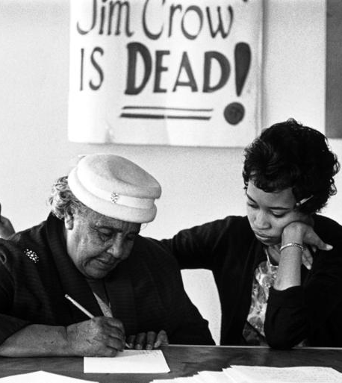
CR Cont’d
Voting Rights Act, 1965
  to insure voting rights for all Americans
  The act prohibited literacy tests or other discriminatory practices for voting

Slide 5
Education
The Elementary and Secondary Ed. Act - $1B to help public schools to buy textbooks & stock libraries
Project Head Start for underprivileged preschoolers
Education is “the key to unlock the door to the Great Society.” ~ LBJ

Slide 6
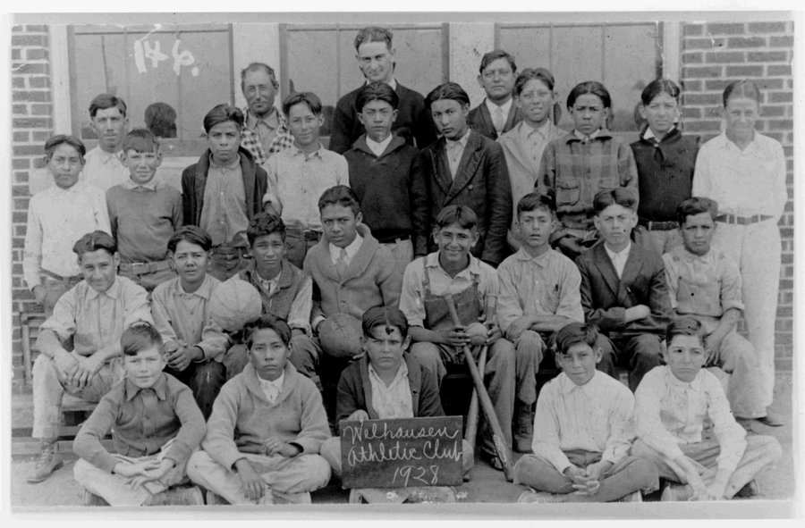
LBJ, Teacher, 1928

Slide 7
Environmental Protection
“To sustain an environment suitable for man, we must fight on a thousand battlegrounds. Despite all of our wealth and knowledge, we cannot create a redwood forest, a wild river, or a gleaming seashore. But we can keep these we have.”
Clean Air Act, 1963
  Regulated corporate air pollution
Water Quality Act of 1965
  required states to clean up their rivers & lakes
  In all, LBJ passed 24 environmental acts!

Slide 8
Consumer Protection
“Americans can feel safer now in their homes, on the road, and at the supermarket.” ~ LBJ
Admin. friendly to consumer advocates
Major safety laws were passed in the U.S. auto industry
Wholesome Meat Act of 1967-add’l consumer protections

Slide 9
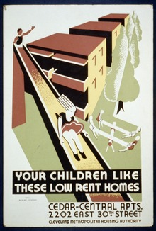
Housing
LBJ & Congress built 240K units of low-rent public housing.
Est’d the Dep’t of Housing & Urban Development (HUD)
Named 1st AA cabinet member, Robert Weaver, as HUD’s 1st leader

Slide 10
Healthcare
Enhanced Social Security in 2 ways:
Medicare provided hospital insurance & low-cost care to the elderly (65+)
Medicaid provided health benefits to the poor
Memory aid:
You care for your elders…medicare.

Slide 11
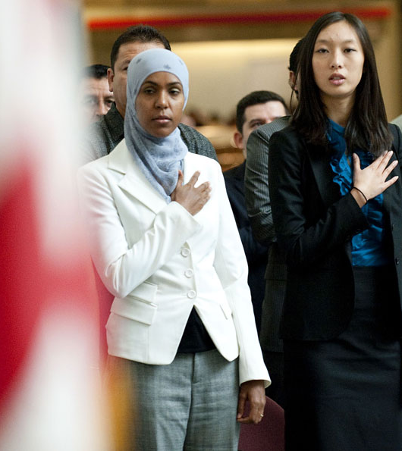
Immigration Reform
The Natural Origins Acts of the 1920s strongly discriminated v. ppl outside of W. Europe
Immigration Act of 1965 opened the door for non-European immigrants to settle in the U.S.

Slide 12
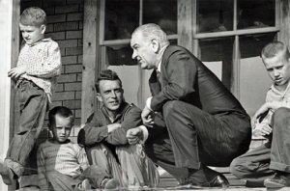
Poverty
Economic Opportunity Act, 1964
  $1B in aid to inner cities.
The Job Corps; VISTA (Volunteers in service to USA).
Lowered Poverty Rate.
Poverty rate 1960 = 22.2%
“ “ 1970 = 12.6%
“ “ 2015 = 13.5%
(gains were all in ‘60s)

Slide 13
