Slide 1
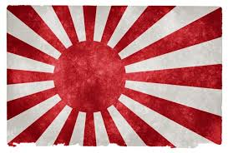
Japanese Militarism
Quick history of modern Japan
Begins modernizing around 1860
In 1905, defeats Russia in Russo-Japanese War.
1st Asian world power in the modern era

Slide 2
Japanese Militarism
Initial Facts
Japan has no oil, no hard coal, and no iron ore.
It wants more land—(which huge country is right next door?)
It must be a trading nation, and a maritime nation.

Slide 3
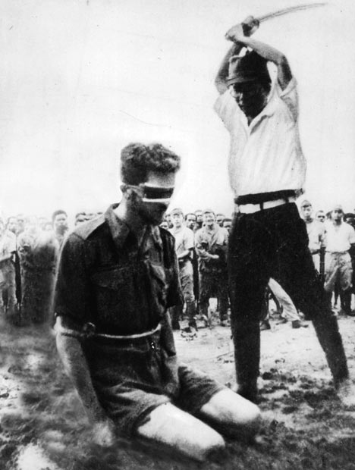
Japanese Militarism
Emperor is god-like, but Army & Navy RULE.
Follow warrior code—bushido (better to die than surrender)
Want a trading/military empire of the Pacific.
Ideology

Slide 4
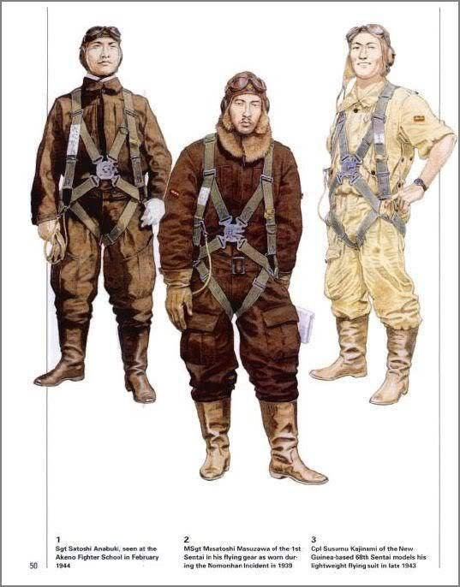
Japanese Militarism
Conquers Manchuria (No. China)
Quits League of Nations.
Signs “Tripartite Pact” w/Germany & Italy. “Axis Powers”
Actions to war

Slide 5
Japanese Militarism
USA is huge power in Pacific (Philippines; trade w/ China…)
US had racially insulted Japanese,
FDR cuts off oil to Japan in 1940
Why does Japan hate USA?
My notes: US Army in summer 1941 is TINY (175,000 men)
US Pacific Fleet is stationed at Pearl Harbor, Hawaii and it is in port...

Slide 6
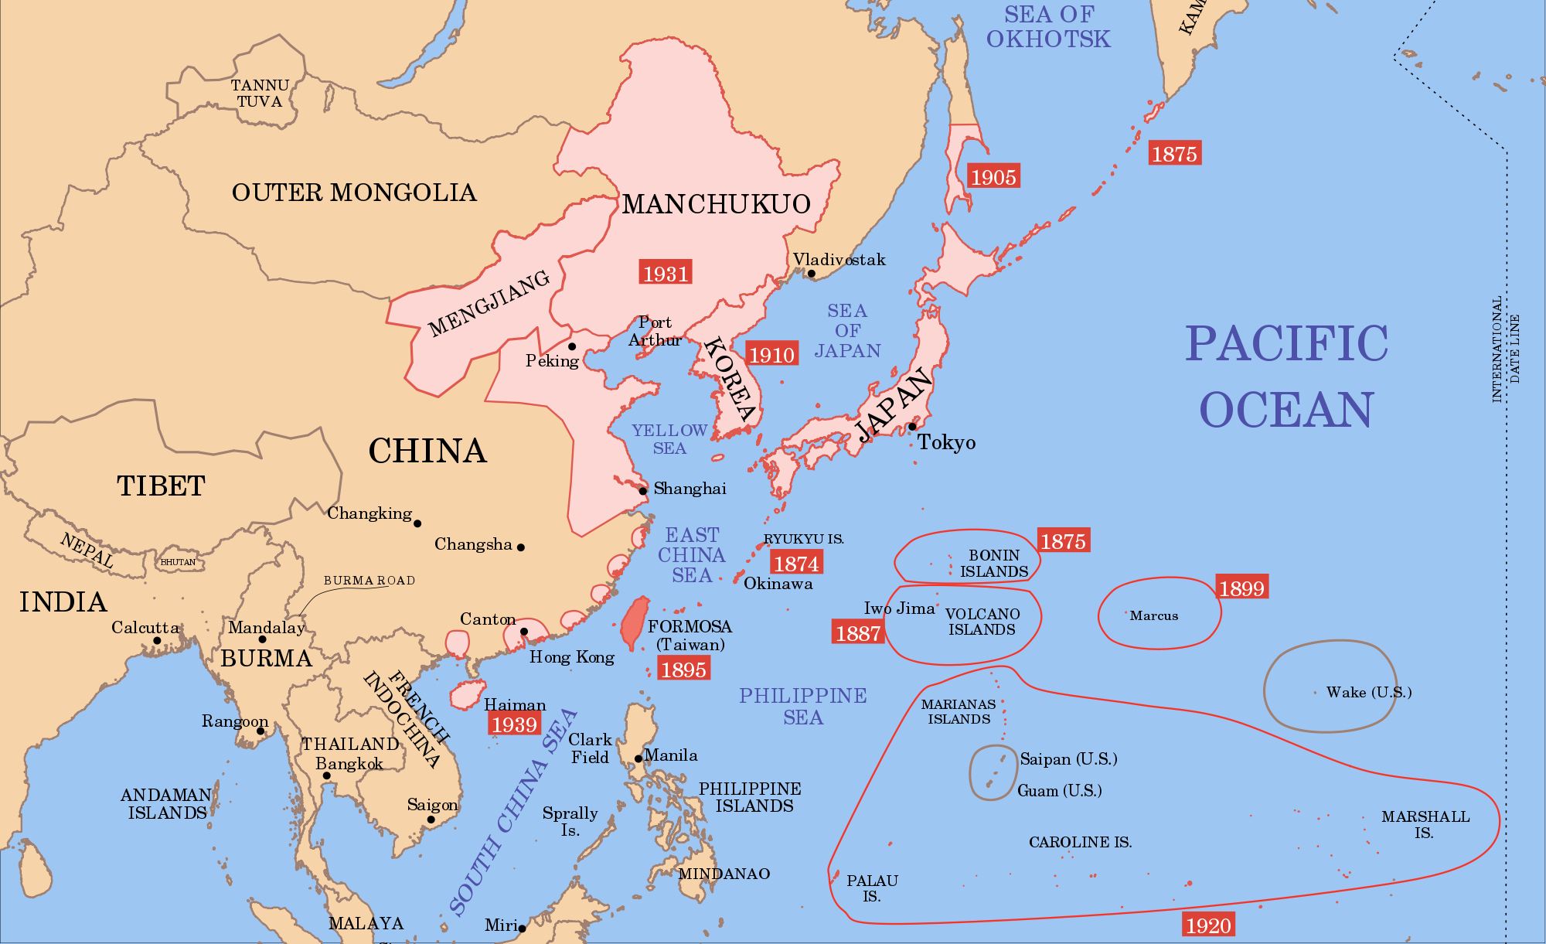

Slide 8
