Slide 1
Tribal ‘20s: Religion
Americans knew that WWI was a turning point, but contested its meaning. What kind of nation would we become? Decades of culture wars have followed.
In this Unit, we will examine religious, racial and ethnic divisions as well as the cultural divides of this turbulent and misunderstood decade.

Slide 2
The Tribal Twenties: Religion

Slide 3
Tribal ’20s-Religion
Protestant Christian; not Roman Catholic (RC)
old immigrants from Britain, Germany, Scandinavia
Anti-immigrant
Live in small towns or rural areas
Who are the Nativists?

Slide 4
Tribal ‘20s-Religion
Mainstream denominations, but also Fundamentalism.
= the belief that the bible is literally true. Distrusts science, secularism, innovation & liberalism.
Evolution v. Creationism?
Nativist religion?
What is fundamentalism?

Slide 5
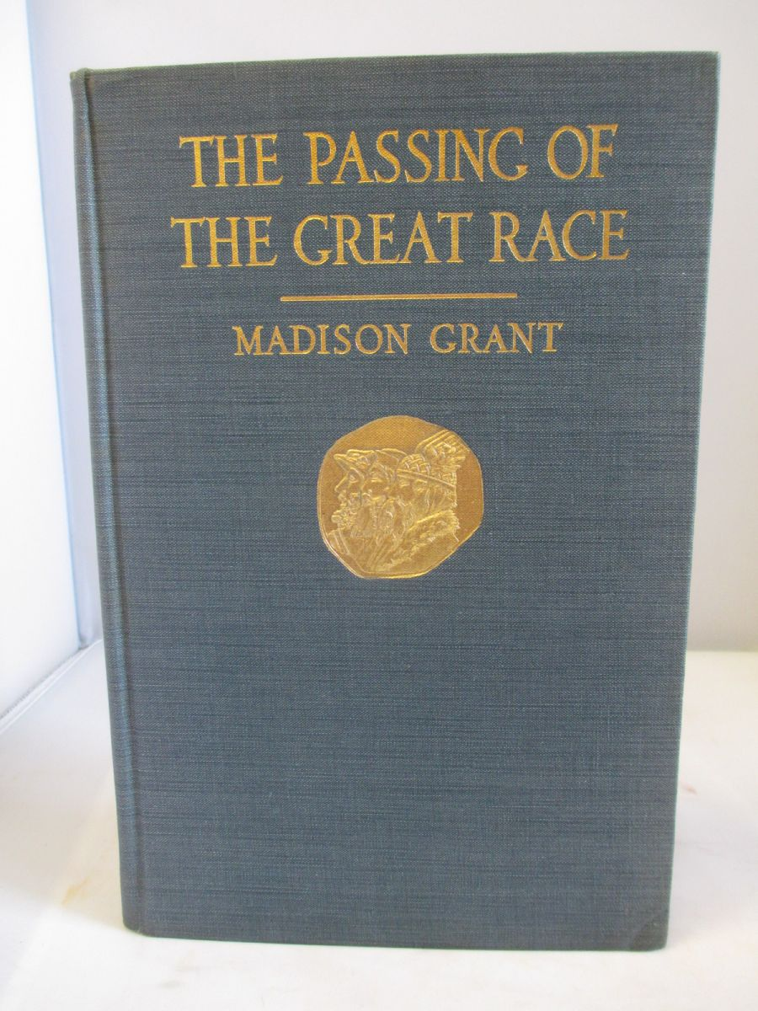
Tribal ‘20s-Religion
Why are the Nativists so active in the 1920s?
They are reading:
The Passing of the Great Race
The Rising Tide of Color
The Character of Races
Applied Eugenics
Postwar anxiety that “pure” “Old American” values are being mixed & diluted by Catholics, Jews, blacks, immigrants.

Slide 6
No Notes; Just Read
According to Nativist author Kenneth Roberts:
“[Immigrants, African-Americans, Roman Catholics, and Jews create] a hybrid race of people as worthless and futile as the good-for-nothing mongrels.”

Slide 7
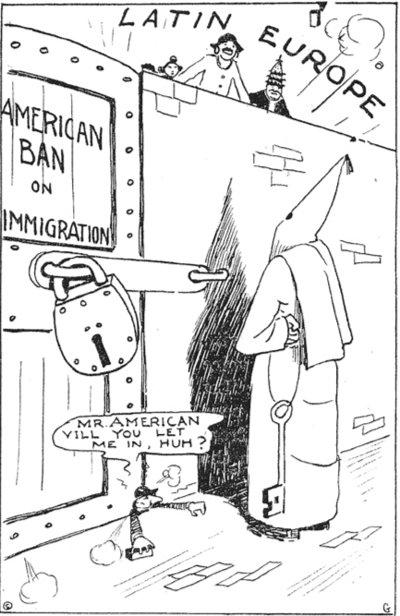

Slide 8
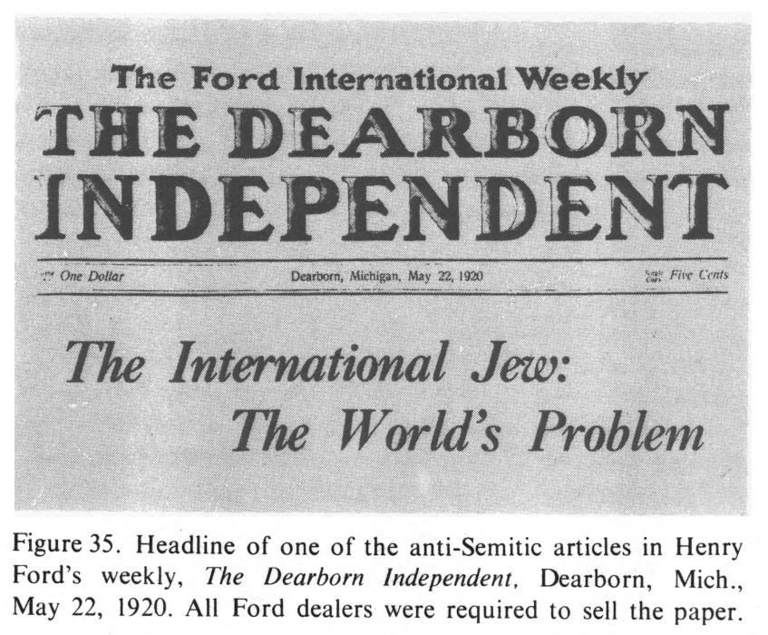

Slide 9
Tribal ‘20s-Religion
Re-emergence of Ku Klux Klan. The ‘20s version is strongly anti-RC. Based in Indiana (North!)
RC = 15% of US; from Italy, Ireland, Poland…
MI & NE tried to ban parochial schools; MO published anti-Catholic newspaper, The Torch.
Nativists v. Roman Catholics (RC)
(Journalist: “anti-Catholicism has become 2d only to the hatred of [blacks]as the moving passion of entire Southern communities.”)

Slide 10
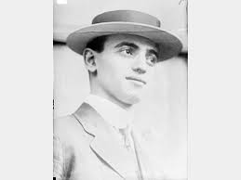
Tribal ‘20s-Religion
Nativists v. American Jews
Frank case. Young girl Mary Phagan murdered in Atlanta; Leo Frank lynched by mob. No charges ever filed.
NYU, Columbia, Harvard restricted # of Jewish students

Slide 11
Tribal ‘20s-Religion
Scopes Trial. HS science teacher tried for teaching evolution in TN.
Case humiliated fundamentalists, who retreated until 1980s. Have been active ever since.
Mainstream v. Fundamentalists
(How do you defend Butler Act in court?)

Slide 12
Summary
Am Society deeply divided along religious lines in the 1920s:
Nativist v. Roman Catholic
Nativist v. Jew
Mainstream v. Fundamentalists

