Slide 1
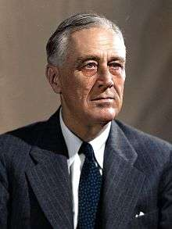
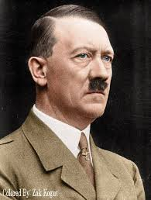
U.S. Response to Hitler, 1939-1941

Slide 2
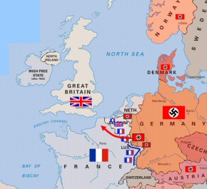
U.S. Response
democracies may buy arms, but must be "cash and carry" (allies only can!). Sales rise.
Debate in Congress rages: 66% of Americans see Germany as a threat.
Neutrality Act of 1939:
Apr-June 1940 Hitler invades Den, Hol, Belg, France
(FDR: "This nation will remain a neutral nation, but I cannot ask that every American remain neutral in thought as well.”)

Slide 3
U.S. Response to Hitler
Selective Service Act: Sept 1940
Four Freedoms Speech
(FDR asked American people to support those “who are resisting aggression and are thereby keeping the war away from our hemisphere.”)
peacetime military draft, 1.2 million troops (will go to 10M+!!!).
State of the Union Jan, 1941 (1) speech & expression, (2) of religion, (3) freedom fr want & (4) freedom fr fear.

Slide 4
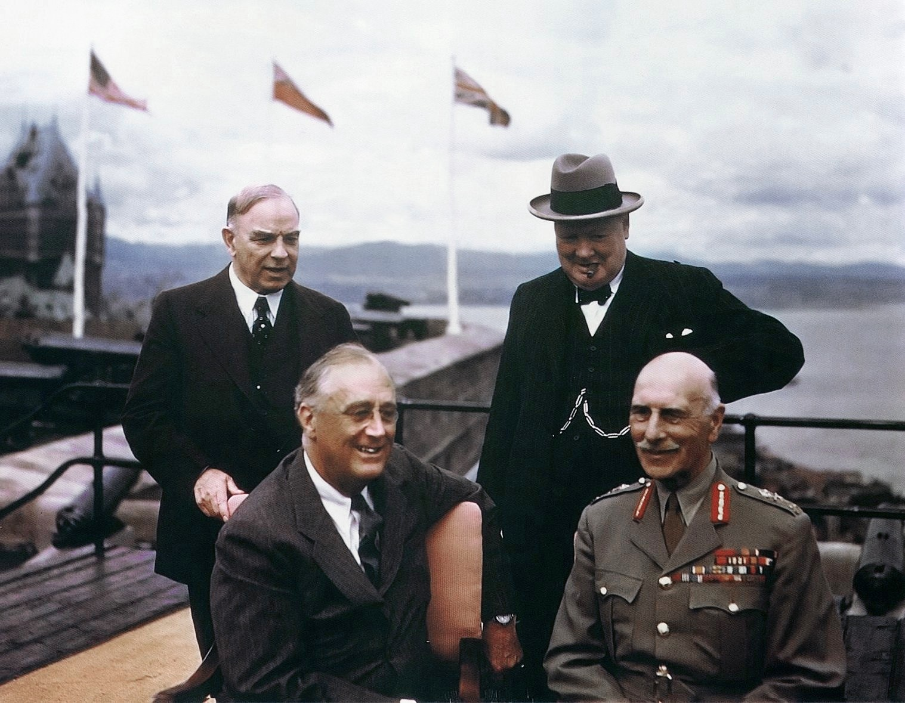
U.S. Reponse
Lend-Lease Act: March 1941
Atlantic Charter: August 1941
Weapons loaned to allies. USA the “arsenal of democracy.” Extended to Russia after the June 1941 invasion of USSR by Hitler.
FDR & Churchill declare “common principles…self-determination & destruction of Nazi tyranny.”
(A nation not at war establishing war aims?!)

Slide 5
Summary
The long period of isolationism is over (for good). FDR wants to help Britain; Congress angry with German aggression. Am PPl readying for war…
(But when? And where? What will be the spark?)

