Slide 1
American Suburb: The American Dream or Bland Conformity

Slide 2
Lining up to see new “model” home

Slide 4
Levitt’s builders: 18 houses before lunch, 18 after lunch.

Slide 5
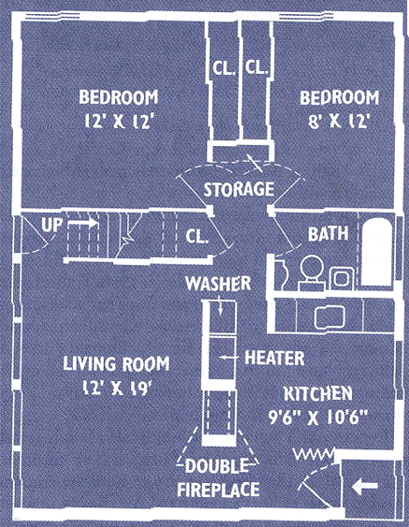
Levitt → Levitttown
1 story high
12’x19’ living room
2 bedrooms
tiled bathroom
garage
small backyard
front lawn

Slide 6
Levittown “Jubilee” Model

Slide 10
Proliferation of Franchises/Strip Malls

Slide 11
Eisenhower: Interstate Highway Act

Slide 16
Middle-Class Suburban Life: Lots of TV

Slide 19
Suburbs and Race (racial covenants)

Slide 24
“Under God”

Slide 26
Summary?
Define a suburb:
List the concepts are connected with suburban life: i.e. homogeneity (“sameness”)…
(HW: Racial exclusions reading Qs)

Slide 27
In-Class Writing
So…Westford is a suburb of Boston. Is your town the stuff of the American Dream, or it is a place of boredom and ennui?
Or a little of both?
Think for a few minutes and then write what you think of suburban life—discuss whay you think are positives and negative.

