Slide 1
Cold War: Causes

Slide 2
Cold War: Causes
NOT a shooting war between the USA & Soviet Union.
A global rivalry that lasts 50 years & polarizes the world.
For US, CW presents both FOREIGN & DOMESTIC threats.
First, the basics.

Slide 3
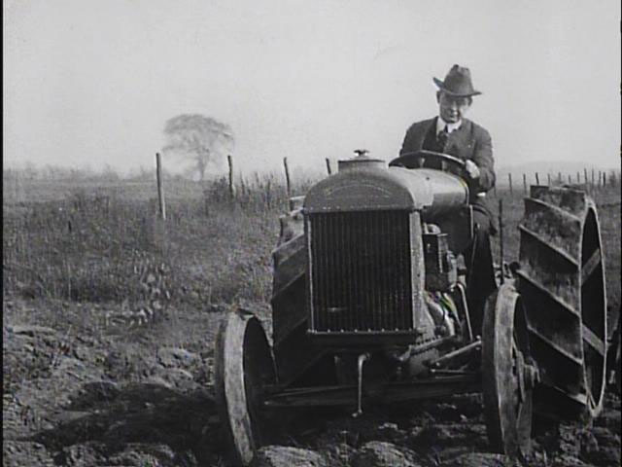
CW
Americans have:
Location far from enemies
Ingenious Constitution
Abundant Nat’l resources
DISTRUST STRONG LEADERS
Long-term causes

Slide 4
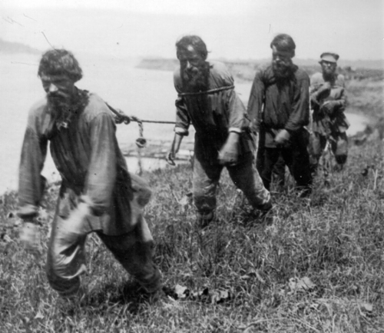
CW
Russians have:
Enemies on their border; history of invasion
Faith in STRONG LEADERS
Conviction that capitalism must be wiped out!
Long-term causes:

Slide 5
CW
20M Soviet dead in WWII. 100X American deaths!
Soviets bore greater burden, want greater influence in Europe
They want E. Europe to be a buffer zone
Short-term causes (aftermath of WWII)
Gravestones in Cambridge

Slide 6
CW
Soviets mistrust USA
D-Day not until 1944
USSR has stronger leader. Stalin in power since 1929; Truman since Apr ‘45.
Soviets have clear post-war goals; US vague goals
Short-term causes:
(Spies, Stalin & Truman)

Slide 7
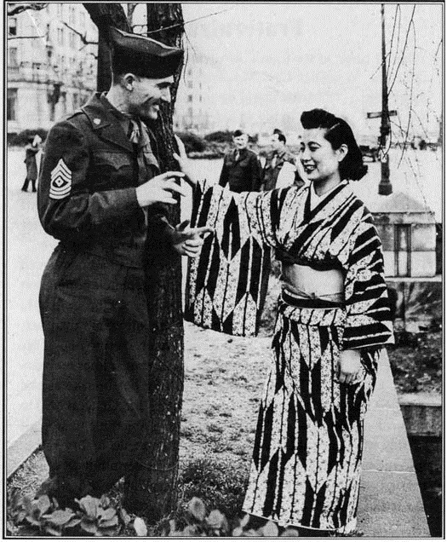
Cold War: Causes
OK. It’s summer/fall 1945, who is the occupying army in Japan? Why?

Slide 8
Red Army occupies Eastern Europe (incl. E. Germany)

Slide 9
Soviet expansion, 1945-> On your map, label the 9 countries under Communist control ( + the two states in SE Europe)

