Slide 1
Sunday, December 7, 1941

Slide 2
Santa Barbara, California
We didn't catch the actual words that the announcer said, but the voice was so tense, so full of emotion, that we all froze. I was absolutely stunned. I thought, My God, it's happening to me. Then came the hideous fear that the bombers would come and we'd all be killed. It was a horrible moment.
Dellie Hahne

Slide 3
Port Barre, Louisiana
I was in the 8th grade and was at my friend Doris’s home. We were playing some kind of game on their living room floor. Her dad was in an easy chair reading a newspaper, and the radio was on; an announcer broke into the music and said, “The Japanese have just bombed Pearl Harbor.” I ran home to tell my parents and they were as shocked as everyone--stunned.
Mary P.

Slide 4
Whittier, California
[After hearing the news, my fiancé, George] left at seven the next morning. I saw him again for three days in June when his ship took on provisions in San Diego, then I didn't see him until June of 1944.
Rachel Wray

Slide 5
Chicago, Illinois
I knew that this was a turning point, that our lives would never be the same again.
Edward Osberg

Slide 6
Washington, D.C. Monday, December 8th
President Roosevelt delivers this address before a joint session of Congress. Read along.
http://www.youtube.com/watch?v=3VqQAf74fsE

Slide 7
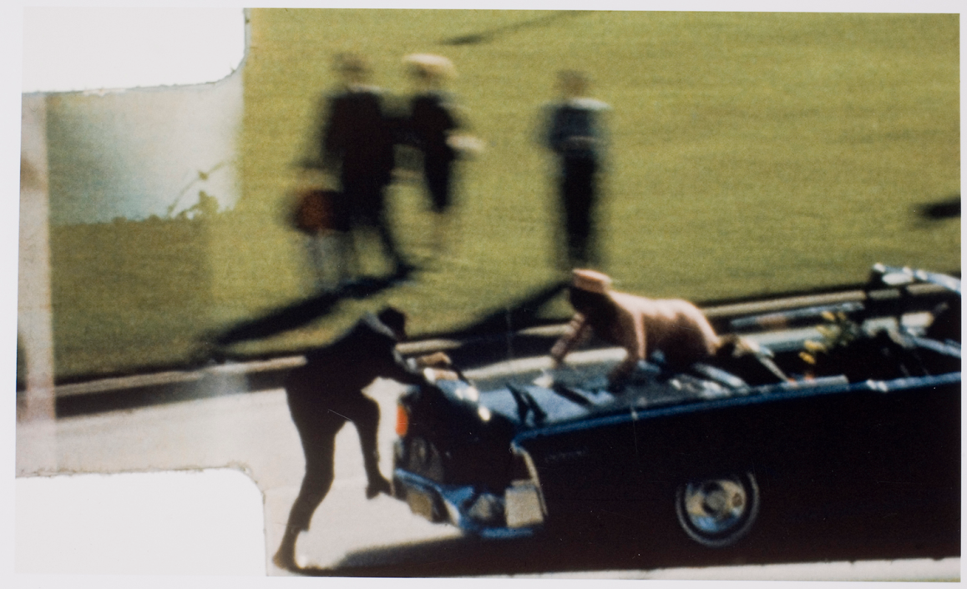
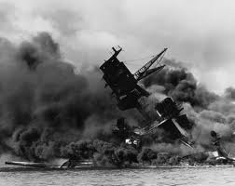
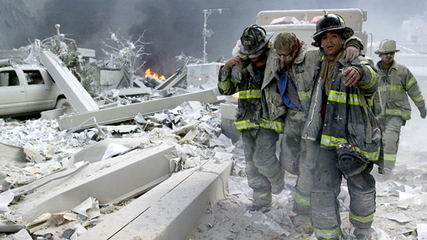
Pearl Harbor, JFK, 9/11

Slide 8
Aircraft Carriers & Infamy: Pearl Harbor Attack
Japanese strike force
(IJN = Imperial Japanese Navy)
At sea, 300 miles N. of Pearl Harbor
Made up of all 6 IJN aircraft carriers
On board: 420 planes-- fighters, bombers, torpedo planes & dive bombers

Slide 9
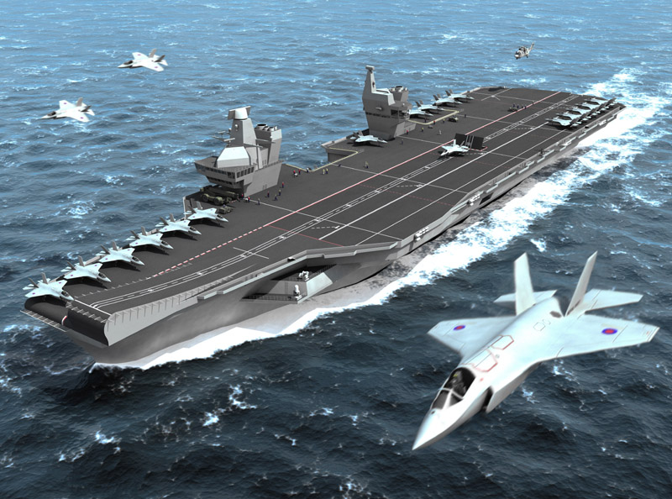
Aircraft Carriers & Infamy
1st one, invented by Japan, could carry 15 planes.
By 1941, 3 football fields long.
Could carry 80 fighter planes & sail 35 MPH!
Today, USS Nimitz’s tower is 20 storeys tall. Has its own zip code! 5 football fields long. 4.5 acre flight deck!
Aircraft Carriers-the backbone of the modern navy (Qs 1-3)

Slide 10
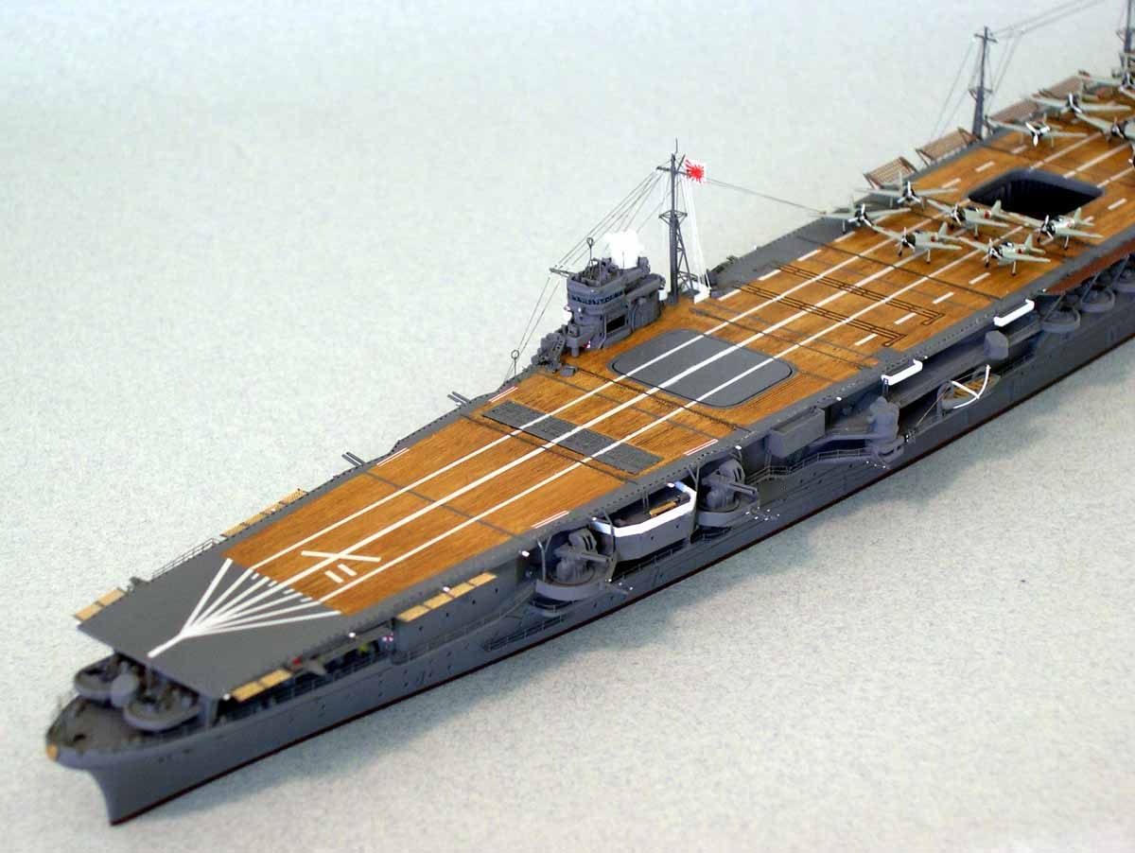

Slide 11
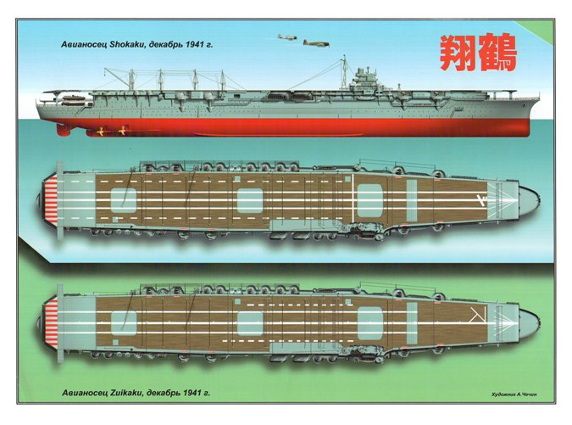

Slide 12
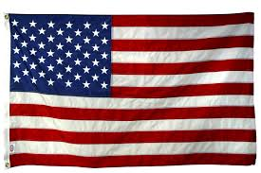
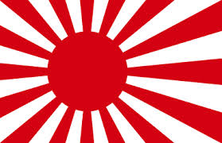
US Enters WWII
Why are Aircraft Carriers so important in the Pacific?
(let’s pause here & try to come up with 3 reasons- Q #4)

Slide 13
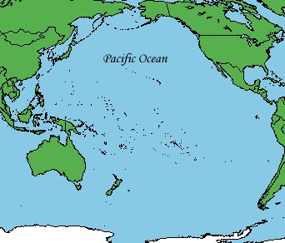
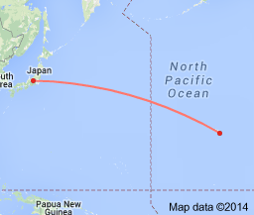
Limitless Strike Capability
California to Hawaii – 2500 miles
Hawaii to Japan – 4100 miles

Slide 14
Expensive/Scarcity
Building Aircraft Carriers is expensive & time-consuming
IJN has only 6
US has only 5
Lexington
Yorktown
Hornet
Wasp
Enterprise

Slide 15
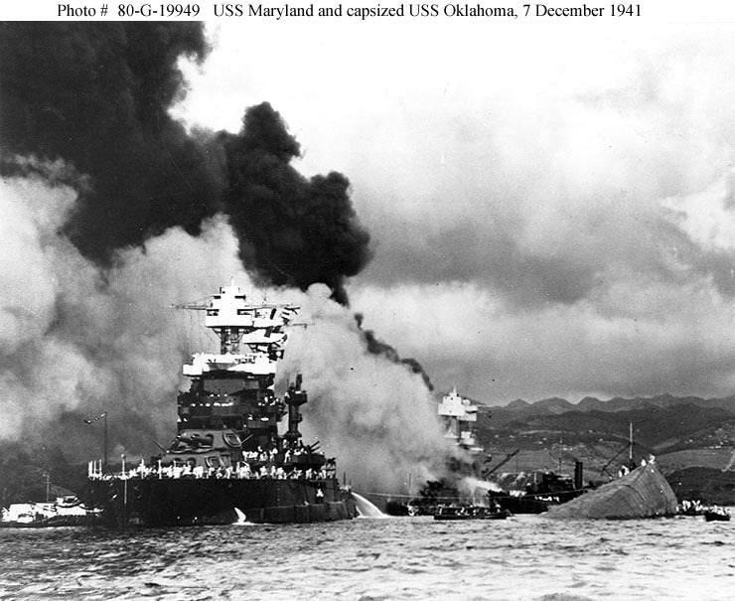
US Enters WWII
1st wave arrived at 7:48 AM as sailors were eating breakfast
8 battleships in “Battleship Row”
USS Arizona (1,777 dead),
Oklahoma (429 dead)
W. Virginia (106 dead; men trapped until Dec. 23d).
California (100 dead)
Nevada (60 dead)
Tenn, Maryland, Penn also hit
Damage inflicted
(Qs 5 &6)

Slide 16
Summary
The surprise attack on Pearl Harbor was devastating, but it could have been much worse. The Japanese did not carry out their plan to destroy the entire naval base (fuel storage, airfields, etc.). Also, the US carriers were luckily out at sea. (Q7)
The US and Japan are at war. This war will hinge on these carriers. The nation that wins the carrier battle (and has the oil) will rule the Pacific and win the war.

Slide 17
Dec. 7, 1941
http://www.schooltube.com/video/d9f27eab2b9336300895/The-attack-on-Pearl-Harbor-from-the-movie-Pearl-Harbor

